Slide 1
DEM Session:
Benefits 2022
What You Need to Know
Annual Benefits Enrollment
September 27 through October 22, 2021
For Benefits Starting January 1, 2022
Ann Bradshaw, Divisional Human Resources Manager
Paula Gates, Divisional Human Resources Specialist

Slide 2
Prepare
What insurance do I have now?
How will plans change in 2022?
Decide
Do I need to reenroll in any of my plans?
What changes can I make to my plans?
Act
I must select benefits online.
Deadline is October 22, 2021 at 4:30 p.m.

Slide 3
Prepare
Attend OHR Benefits Services Benefits 2022: What you need to know
Thurs., October 14, 9:00-10:00 a.m.
Friday, October 15, 1:00-2:00 p.m.
Pre-register at http://www.benefits.wisc.edu/2022 on the calendar of events.
Watch the recorded video:
https://www.youtube.com/watch?v=5JqB0uYNWOo

Slide 4
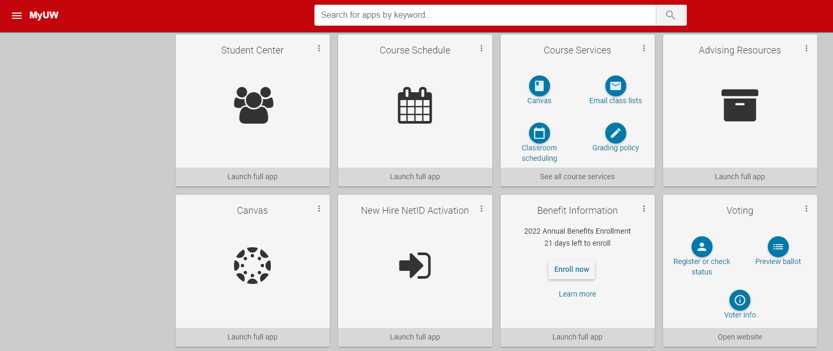
Prepare
2. Check your current benefits at https://my.wisc.edu
(located in the Benefit Information tile)

Slide 5
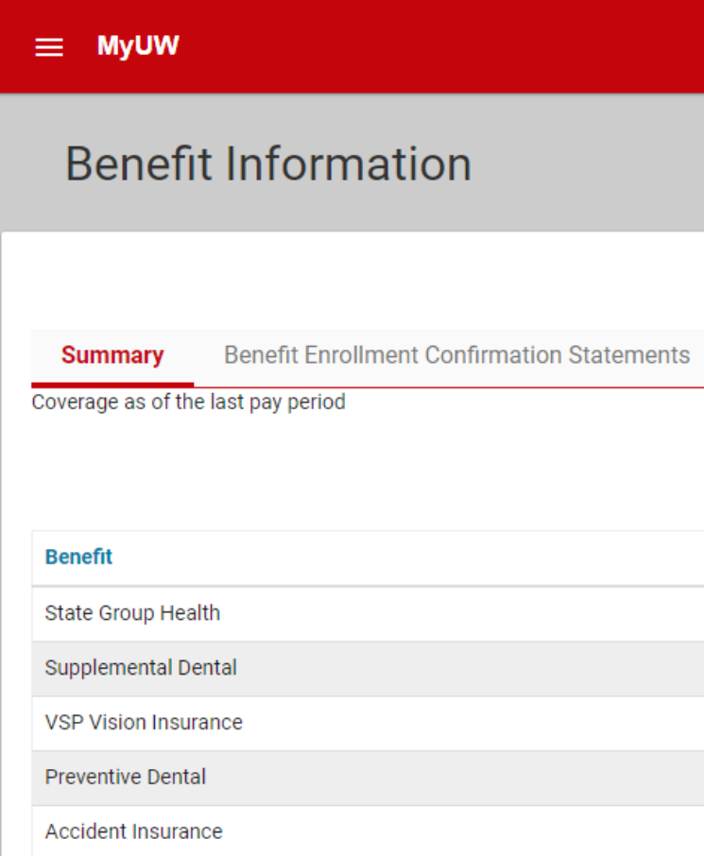
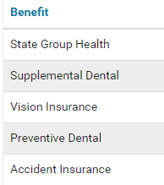
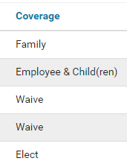
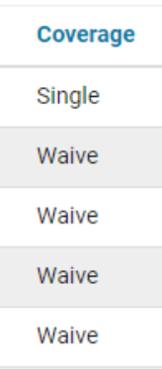
Prepare
Check your current benefits at https://my.wisc.edu
(located in the Benefit Information tile). Click on Benefit Information.

Slide 6
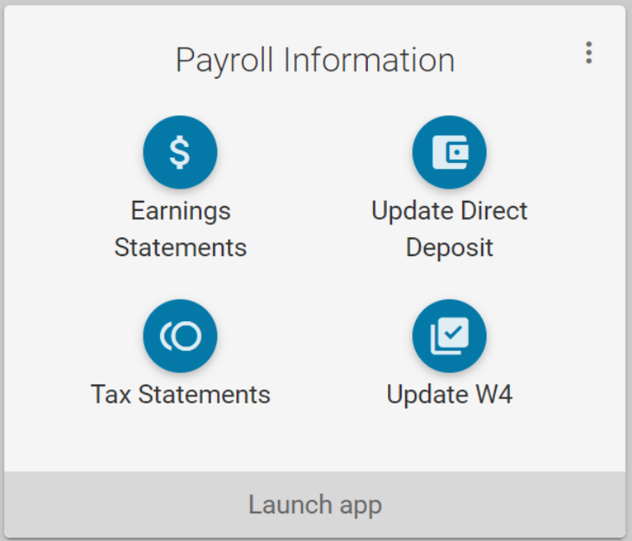
Prepare
Check your current benefits by looking at your earnings statements at https://my.wisc.edu (located in the Payroll Information tile). Click on Earnings Statements.

Slide 7
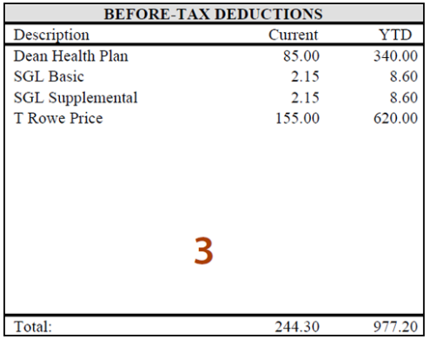
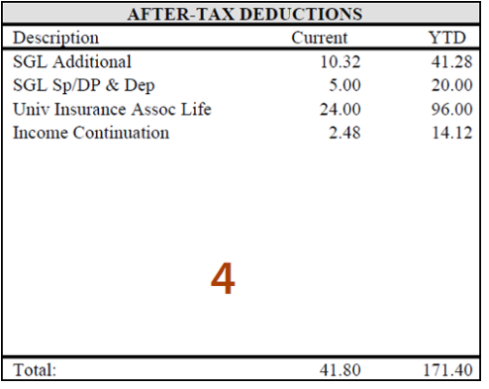
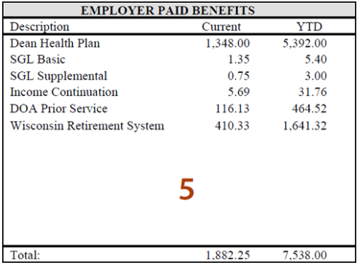
Prepare
Check your current benefits through your earnings statements at https://my.wisc.edu (located in the Payroll Information tile). Click on Earnings Statements.
Your Earnings Statement shows what you paid for in 2021:
Insurance plans
Parking, retirement, etc.

Slide 8

Prepare
3. Visit Alex, your personal virtual benefits counselor.
ALEX is an online resource to help you better understand the comprehensive benefits offered to UW-Madison team members. ALEX will ask you a series of questions to walk you through your benefits options and suggests plans based on your answers.
https://www.myalex.com/uwsystem/2021

Slide 9

Prepare
Use the Wisconsin Department of Employee Trust Funds (ETF)’s resources.
Employee Trust Fund’s Decision Guide 2021
https://etf.wi.gov/resource/its-your-choice-2022-decision-guide-state-wisconsin-group-health-insurance-employees
Visit the UW System Annual Benefits Enrollment website: https://www.wisconsin.edu/abe/
Visit the OHR Annual Benefits Enrollment website: https://hr.wisc.edu/benefits/annual-benefits-enrollment/

Slide 10
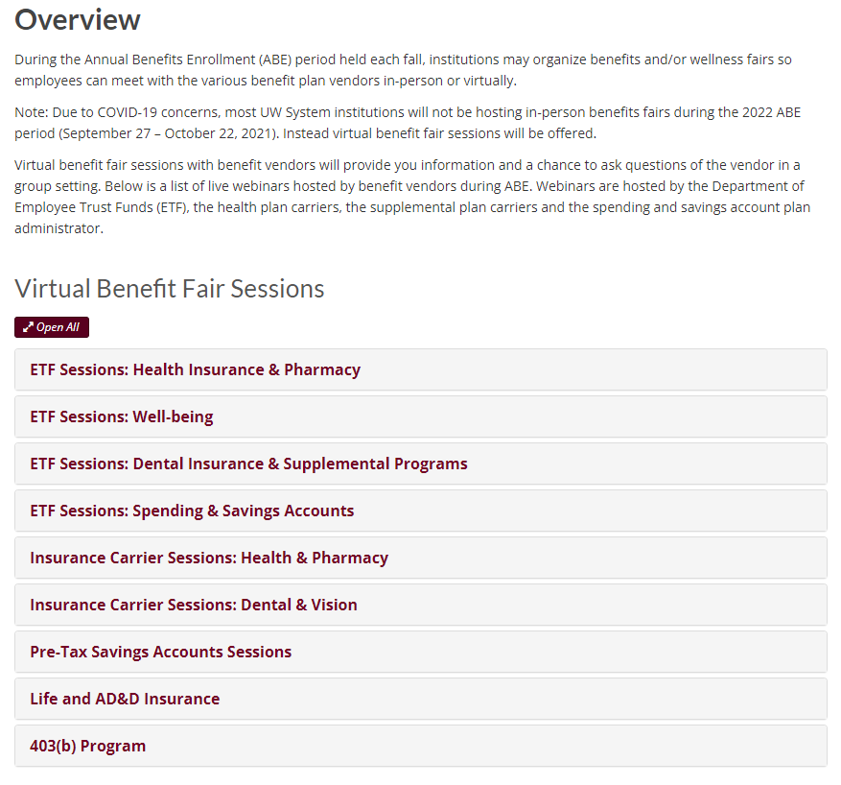
Prepare
Use the Wisconsin Department of Employee Trust Funds (ETF)’s resources.
Sign up for ETF’s Virtual Benefit Fair Sessions
https://www.wisconsin.edu/ohrwd/total-rewards/events/fairs/

Slide 11
Decide
Health Insurance
Dental Insurance
Vision Insurance
Pre-Tax Health and Spending Accounts
Pre-Tax Parking and Transit
Accident
Long-Term Care
Life Insurance

Slide 12
Health Insurance
What will change January 1
What will not change January 1
Monthly Premiums Increase
  Most will pay an additional $1 to $8 per bi-weekly paycheck
  Crafts Workers are eligible for employer contributions
  Quartz-Community Network
    Dividing into two new networks
    FYI-no change with Dane Co. Quartz-UW Health
How your insurance works
  Same deductibles, co-pays & co-insurance
Dane County health provider networks:
  Dean
  GHC-SCW
  Quartz-UW Health
  Access and Access HDHP with WEA Trust
Notes:
With a High Deductible Health Plan, the medical deductible must be met before copays and coinsurance begin.
Example: Before meeting his $1,500 deductible, Joe must pay the full cost of the office visit, including any services or labs. After his deductible, he will only be responsible for 10% of his medical costs.
With a non-high deductible plan, office copays begin before the deductible is met.
Example: Maria chose a health plan with a $250 deductible. Before meeting her deductible, she will pay a $15 copay for an office visit plus the costs of any labs or services. After her deductible, she will continue paying the office visit copay but only be responsible for 10% of labs and services costs.

Slide 13
Health Insurance
Health Insurance Changes
New Coverage starting January 1, 2022
Orthognathic surgery (corrective jaw surgery) is an allowed service.
Colonoscopy screenings are allowed earlier, at age 45.
Continuous glucose monitors expanded to pharmacy benefit (you may choose to get CGMs through your health plan or Navitus).
Notes:
With a High Deductible Health Plan, the medical deductible must be met before copays and coinsurance begin.
Example: Before meeting his $1,500 deductible, Joe must pay the full cost of the office visit, including any services or labs. After his deductible, he will only be responsible for 10% of his medical costs.
With a non-high deductible plan, office copays begin before the deductible is met.
Example: Maria chose a health plan with a $250 deductible. Before meeting her deductible, she will pay a $15 copay for an office visit plus the costs of any labs or services. After her deductible, she will continue paying the office visit copay but only be responsible for 10% of labs and services costs.

Slide 14
Health Insurance
What changes can you make?
Newly enroll in Health Insurance Coverage
Enroll in the Opt-Out Incentive (you must re-elect it each year)
Change Plan Design (IYC, HDHP, Access)
Change Health Plan Network (GHC, Quartz, Dean, etc.)
Add or Remove Dependents
Add or Remove Uniform Dental with Health Insurance
Cancel Coverage
Notes:
With a High Deductible Health Plan, the medical deductible must be met before copays and coinsurance begin.
Example: Before meeting his $1,500 deductible, Joe must pay the full cost of the office visit, including any services or labs. After his deductible, he will only be responsible for 10% of his medical costs.
With a non-high deductible plan, office copays begin before the deductible is met.
Example: Maria chose a health plan with a $250 deductible. Before meeting her deductible, she will pay a $15 copay for an office visit plus the costs of any labs or services. After her deductible, she will continue paying the office visit copay but only be responsible for 10% of labs and services costs.

Slide 15
Health Insurance
Do you like the coverage you already have?
You still must make a new election for 2022 if you want:
  High Deductible Health Plan (HDHP) or Access HDHP, and re-elect the Health Savings Account (HSA) for 2022
  Opt-Out Incentive for 2022
You must make a new election for 2022 if you have:
  Quartz-Community as your health network
Notes:
With a High Deductible Health Plan, the medical deductible must be met before copays and coinsurance begin.
Example: Before meeting his $1,500 deductible, Joe must pay the full cost of the office visit, including any services or labs. After his deductible, he will only be responsible for 10% of his medical costs.
With a non-high deductible plan, office copays begin before the deductible is met.
Example: Maria chose a health plan with a $250 deductible. Before meeting her deductible, she will pay a $15 copay for an office visit plus the costs of any labs or services. After her deductible, she will continue paying the office visit copay but only be responsible for 10% of labs and services costs.

Slide 16
Health Insurance
Health Insurance Changes
Quartz-Community health plan network ends December 31, 2021.
You must choose a new health network if you:
  Had Quartz-Community in 2021.
  You can enroll in any of the networks available (not limited to Quartz Central or Quartz West)
Quartz Central is a new option if you live in south-central Wisconsin (but not in Dane County).
Quartz West is a new option if you live in west-central Wisconsin.
Aspirus is a new option if you live in north-central Wisconsin.
Quartz-UW Health will still offer coverage in Dane County
Notes:
With a High Deductible Health Plan, the medical deductible must be met before copays and coinsurance begin.
Example: Before meeting his $1,500 deductible, Joe must pay the full cost of the office visit, including any services or labs. After his deductible, he will only be responsible for 10% of his medical costs.
With a non-high deductible plan, office copays begin before the deductible is met.
Example: Maria chose a health plan with a $250 deductible. Before meeting her deductible, she will pay a $15 copay for an office visit plus the costs of any labs or services. After her deductible, she will continue paying the office visit copay but only be responsible for 10% of labs and services costs.

Slide 17
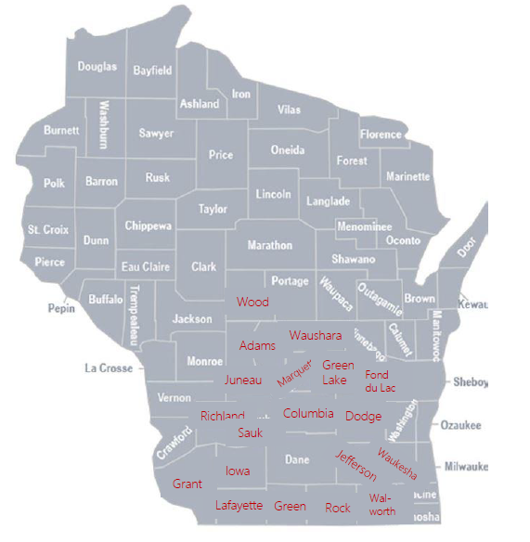
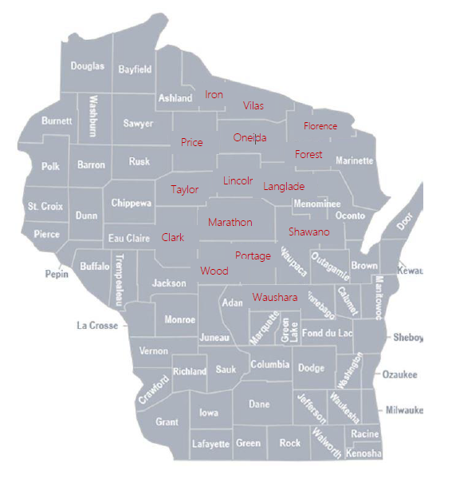
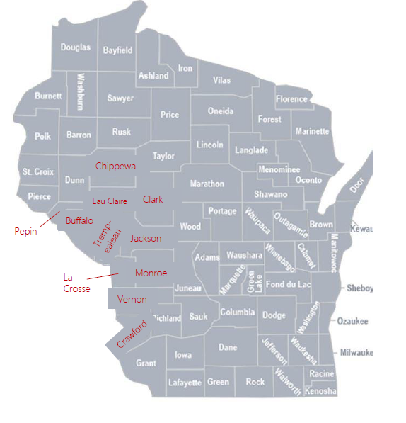
Health Insurance
Quartz-Central, Quartz-West, and Aspirus are new options
Health Insurance Changes
Quartz West
Quartz Central
Aspirus
Notes:
With a High Deductible Health Plan, the medical deductible must be met before copays and coinsurance begin.
Example: Before meeting his $1,500 deductible, Joe must pay the full cost of the office visit, including any services or labs. After his deductible, he will only be responsible for 10% of his medical costs.
With a non-high deductible plan, office copays begin before the deductible is met.
Example: Maria chose a health plan with a $250 deductible. Before meeting her deductible, she will pay a $15 copay for an office visit plus the costs of any labs or services. After her deductible, she will continue paying the office visit copay but only be responsible for 10% of labs and services costs.

Slide 18
Health Insurance
Health Insurance Changes
See the full list of health networks and provider listings on ETF’s website:
https://etf.wi.gov/its-your-choice/2022/health-plan-search/state
Notes:
With a High Deductible Health Plan, the medical deductible must be met before copays and coinsurance begin.
Example: Before meeting his $1,500 deductible, Joe must pay the full cost of the office visit, including any services or labs. After his deductible, he will only be responsible for 10% of his medical costs.
With a non-high deductible plan, office copays begin before the deductible is met.
Example: Maria chose a health plan with a $250 deductible. Before meeting her deductible, she will pay a $15 copay for an office visit plus the costs of any labs or services. After her deductible, she will continue paying the office visit copay but only be responsible for 10% of labs and services costs.

Slide 19
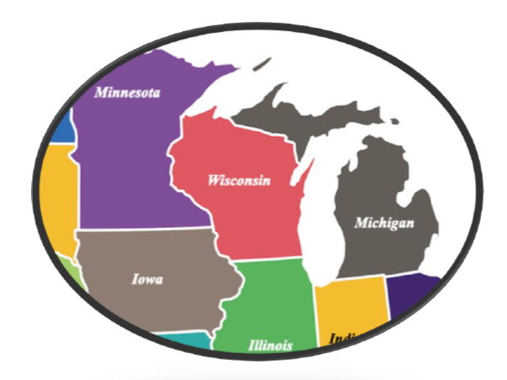
Health Insurance
Health Insurance Changes
If you plan to seek medical care outside Wisconsin in a surrounding state (e.g., Illinois, Iowa, Michigan, Minnesota), there may be an IYC Health Plan network that will offer you in-network options.
https://etf.wi.gov/its-your-choice/2022/health-plan-search/state
Notes:
With a High Deductible Health Plan, the medical deductible must be met before copays and coinsurance begin.
Example: Before meeting his $1,500 deductible, Joe must pay the full cost of the office visit, including any services or labs. After his deductible, he will only be responsible for 10% of his medical costs.
With a non-high deductible plan, office copays begin before the deductible is met.
Example: Maria chose a health plan with a $250 deductible. Before meeting her deductible, she will pay a $15 copay for an office visit plus the costs of any labs or services. After her deductible, she will continue paying the office visit copay but only be responsible for 10% of labs and services costs.

Slide 20
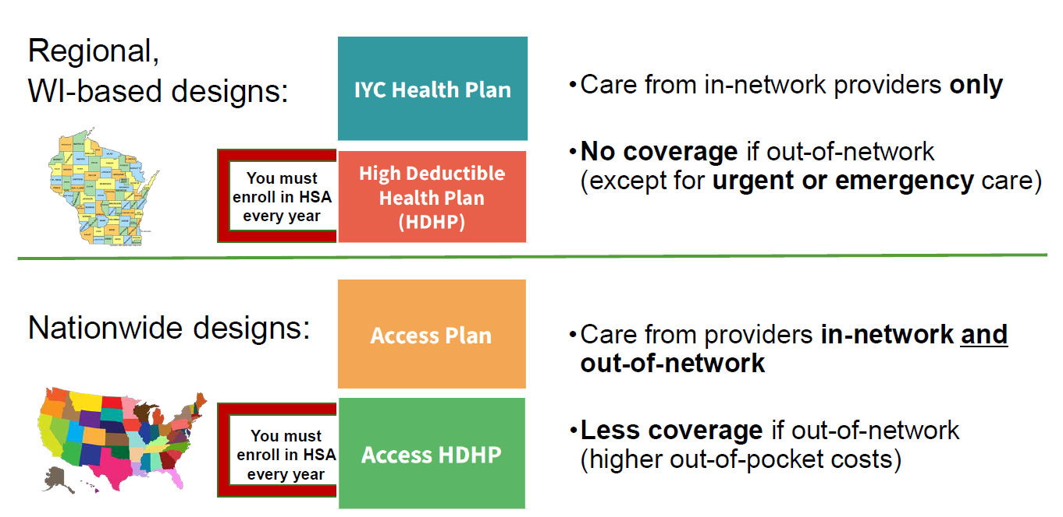
Health Insurance
Choose 1 Design
Notes:
With a High Deductible Health Plan, the medical deductible must be met before copays and coinsurance begin.
Example: Before meeting his $1,500 deductible, Joe must pay the full cost of the office visit, including any services or labs. After his deductible, he will only be responsible for 10% of his medical costs.
With a non-high deductible plan, office copays begin before the deductible is met.
Example: Maria chose a health plan with a $250 deductible. Before meeting her deductible, she will pay a $15 copay for an office visit plus the costs of any labs or services. After her deductible, she will continue paying the office visit copay but only be responsible for 10% of labs and services costs.

Slide 21


Health Insurance
Choose 1 Design
Watch Employee Trust Fund videos:
https://etf.wi.gov/video/choosing-plan-design
Ask ALEX!
https://www.wisconsin.edu/ohrwd/benefits/alex/
Notes:
With a High Deductible Health Plan, the medical deductible must be met before copays and coinsurance begin.
Example: Before meeting his $1,500 deductible, Joe must pay the full cost of the office visit, including any services or labs. After his deductible, he will only be responsible for 10% of his medical costs.
With a non-high deductible plan, office copays begin before the deductible is met.
Example: Maria chose a health plan with a $250 deductible. Before meeting her deductible, she will pay a $15 copay for an office visit plus the costs of any labs or services. After her deductible, she will continue paying the office visit copay but only be responsible for 10% of labs and services costs.

Slide 22
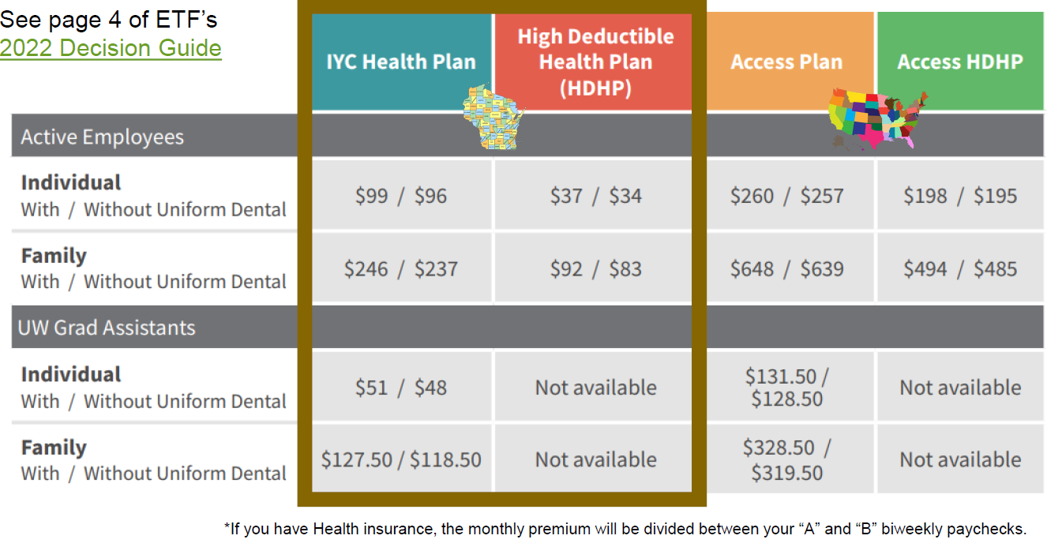
2022 Health Insurance Costs
(shown as monthly premium that are automatically divided between A & B bi-weekly paychecks)
Health Insurance
See page 4 of ETF’s
2022 Decision Guide
Notes:
With a High Deductible Health Plan, the medical deductible must be met before copays and coinsurance begin.
Example: Before meeting his $1,500 deductible, Joe must pay the full cost of the office visit, including any services or labs. After his deductible, he will only be responsible for 10% of his medical costs.
With a non-high deductible plan, office copays begin before the deductible is met.
Example: Maria chose a health plan with a $250 deductible. Before meeting her deductible, she will pay a $15 copay for an office visit plus the costs of any labs or services. After her deductible, she will continue paying the office visit copay but only be responsible for 10% of labs and services costs.

Slide 23
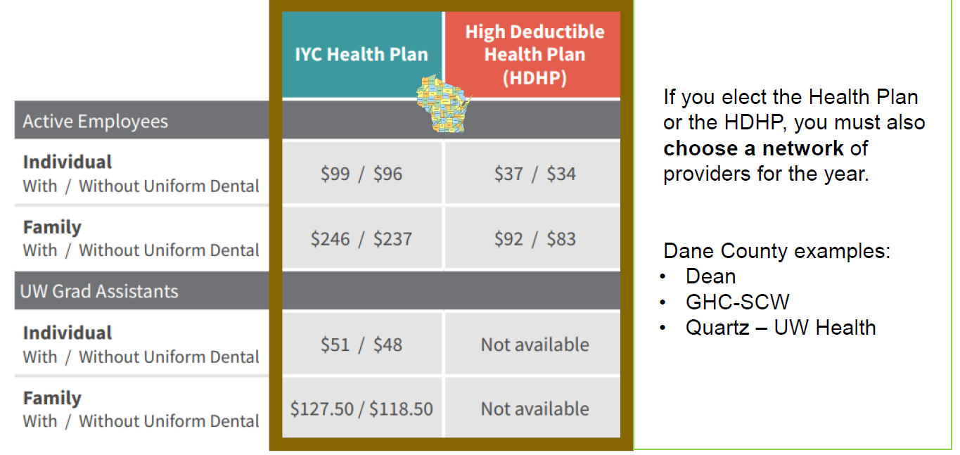
Health Insurance
2021 Health Insurance Costs
(Shown as monthly premiums which are evenly divided between
bi-weekly A & B paychecks)
Notes:
With a High Deductible Health Plan, the medical deductible must be met before copays and coinsurance begin.
Example: Before meeting his $1,500 deductible, Joe must pay the full cost of the office visit, including any services or labs. After his deductible, he will only be responsible for 10% of his medical costs.
With a non-high deductible plan, office copays begin before the deductible is met.
Example: Maria chose a health plan with a $250 deductible. Before meeting her deductible, she will pay a $15 copay for an office visit plus the costs of any labs or services. After her deductible, she will continue paying the office visit copay but only be responsible for 10% of labs and services costs.

Slide 24
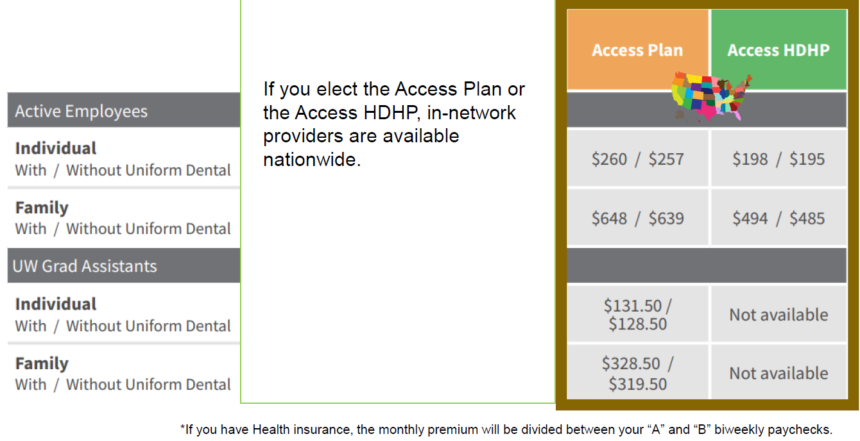
2021 Health Insurance Costs
(Shown as monthly premiums* that are divided evenly between
bi-weekly A & B paychecks)
Health Insurance
Notes:
With a High Deductible Health Plan, the medical deductible must be met before copays and coinsurance begin.
Example: Before meeting his $1,500 deductible, Joe must pay the full cost of the office visit, including any services or labs. After his deductible, he will only be responsible for 10% of his medical costs.
With a non-high deductible plan, office copays begin before the deductible is met.
Example: Maria chose a health plan with a $250 deductible. Before meeting her deductible, she will pay a $15 copay for an office visit plus the costs of any labs or services. After her deductible, she will continue paying the office visit copay but only be responsible for 10% of labs and services costs.

Slide 25
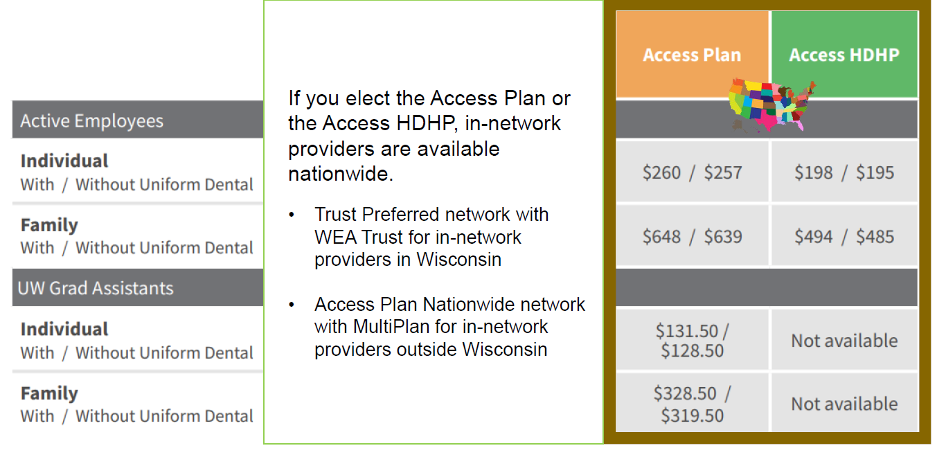
2021 Health Insurance Costs
(Shown as monthly premiums* that are divided evenly between
bi-weekly A & B paychecks)
Health Insurance
Notes:
With a High Deductible Health Plan, the medical deductible must be met before copays and coinsurance begin.
Example: Before meeting his $1,500 deductible, Joe must pay the full cost of the office visit, including any services or labs. After his deductible, he will only be responsible for 10% of his medical costs.
With a non-high deductible plan, office copays begin before the deductible is met.
Example: Maria chose a health plan with a $250 deductible. Before meeting her deductible, she will pay a $15 copay for an office visit plus the costs of any labs or services. After her deductible, she will continue paying the office visit copay but only be responsible for 10% of labs and services costs.

Slide 26
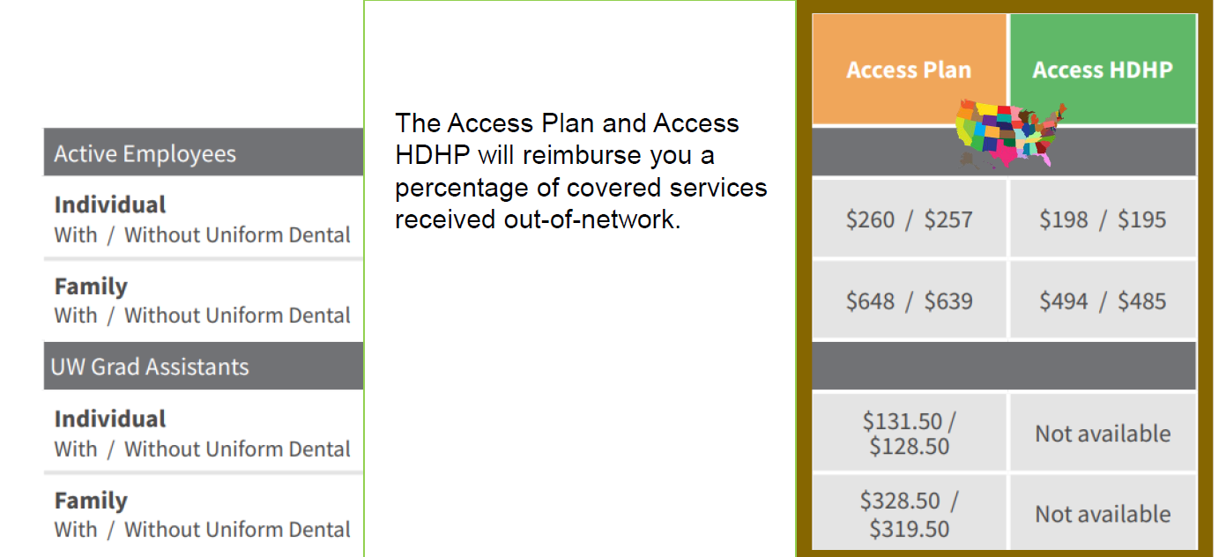
2021 Health Insurance Costs
(Shown as monthly premiums* that are divided evenly between
bi-weekly A & B paychecks)
Health Insurance
Notes:
With a High Deductible Health Plan, the medical deductible must be met before copays and coinsurance begin.
Example: Before meeting his $1,500 deductible, Joe must pay the full cost of the office visit, including any services or labs. After his deductible, he will only be responsible for 10% of his medical costs.
With a non-high deductible plan, office copays begin before the deductible is met.
Example: Maria chose a health plan with a $250 deductible. Before meeting her deductible, she will pay a $15 copay for an office visit plus the costs of any labs or services. After her deductible, she will continue paying the office visit copay but only be responsible for 10% of labs and services costs.

Slide 27
2021 Health Insurance Costs
(Monthly premiums are divided evenly between
bi-weekly A & B paychecks)
Health Insurance
The 2022 monthly health premiums will
  be split between you’re a and B bi-weekly paychecks
  Prepay for the next month’s coverage
Payroll schedules and calendars can be found here:
  2021: https://uwservice.wisconsin.edu/docs/publications/pay-uncl-bw-calendars-2021.pdf
  2022: https://uwservice.wisconsin.edu/docs/publications/2022-biweekly-payroll-calendar.pdf
Notes:
With a High Deductible Health Plan, the medical deductible must be met before copays and coinsurance begin.
Example: Before meeting his $1,500 deductible, Joe must pay the full cost of the office visit, including any services or labs. After his deductible, he will only be responsible for 10% of his medical costs.
With a non-high deductible plan, office copays begin before the deductible is met.
Example: Maria chose a health plan with a $250 deductible. Before meeting her deductible, she will pay a $15 copay for an office visit plus the costs of any labs or services. After her deductible, she will continue paying the office visit copay but only be responsible for 10% of labs and services costs.

Slide 28
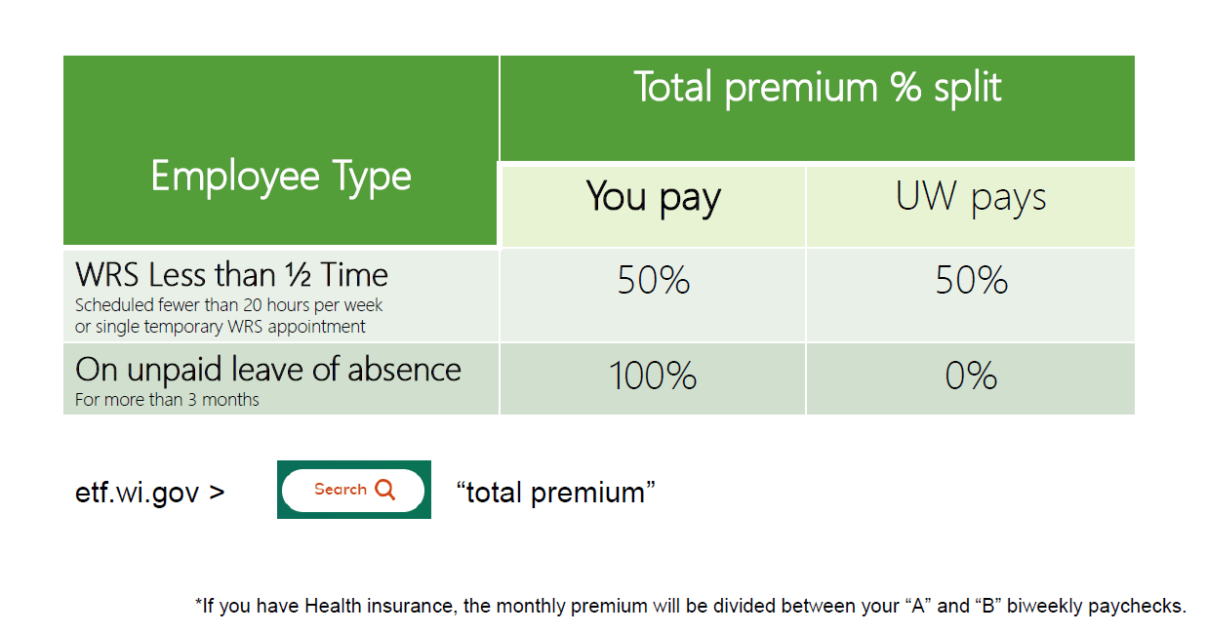
2021 Health Insurance Costs
(Shown as monthly premiums* that are divided evenly between
bi-weekly A & B paychecks)
Health Insurance
If your paycheck is regularly lower than the cost of your Health insurance, you will be billed.
Notes:
With a High Deductible Health Plan, the medical deductible must be met before copays and coinsurance begin.
Example: Before meeting his $1,500 deductible, Joe must pay the full cost of the office visit, including any services or labs. After his deductible, he will only be responsible for 10% of his medical costs.
With a non-high deductible plan, office copays begin before the deductible is met.
Example: Maria chose a health plan with a $250 deductible. Before meeting her deductible, she will pay a $15 copay for an office visit plus the costs of any labs or services. After her deductible, she will continue paying the office visit copay but only be responsible for 10% of labs and services costs.

Slide 29
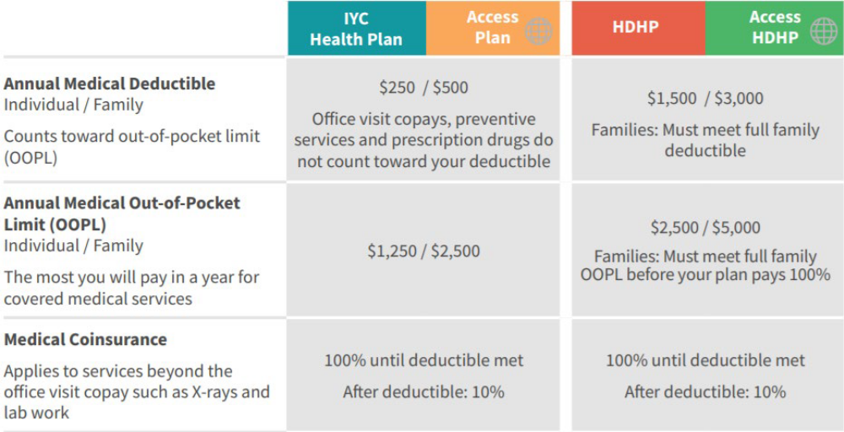
Health Insurance
No changes: co-payments, deductibles, co-insurance, out-of-pocket limits
Notes:
With a High Deductible Health Plan, the medical deductible must be met before copays and coinsurance begin.
Example: Before meeting his $1,500 deductible, Joe must pay the full cost of the office visit, including any services or labs. After his deductible, he will only be responsible for 10% of his medical costs.
With a non-high deductible plan, office copays begin before the deductible is met.
Example: Maria chose a health plan with a $250 deductible. Before meeting her deductible, she will pay a $15 copay for an office visit plus the costs of any labs or services. After her deductible, she will continue paying the office visit copay but only be responsible for 10% of labs and services costs.

Slide 30
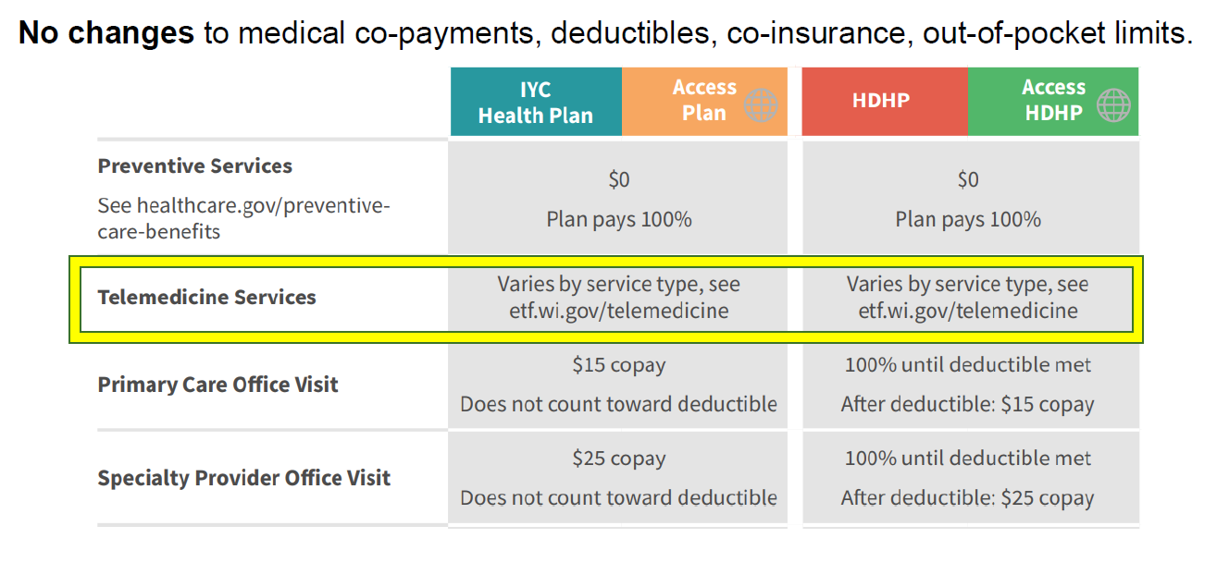
Health Insurance
No changes to medical co-payments, deductibles, co-insurance, out-of-pocket limits.
Notes:
With a High Deductible Health Plan, the medical deductible must be met before copays and coinsurance begin.
Example: Before meeting his $1,500 deductible, Joe must pay the full cost of the office visit, including any services or labs. After his deductible, he will only be responsible for 10% of his medical costs.
With a non-high deductible plan, office copays begin before the deductible is met.
Example: Maria chose a health plan with a $250 deductible. Before meeting her deductible, she will pay a $15 copay for an office visit plus the costs of any labs or services. After her deductible, she will continue paying the office visit copay but only be responsible for 10% of labs and services costs.

Slide 31
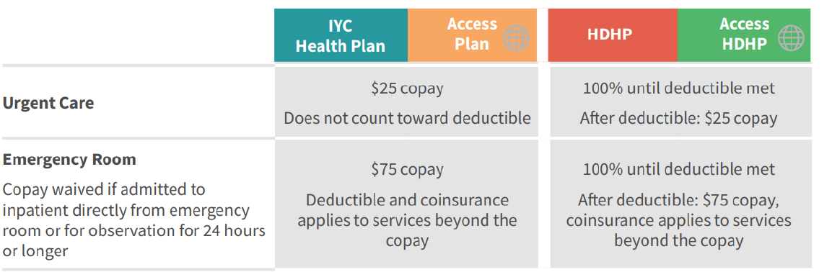
Health Insurance
No changes to medical co-payments, deductibles, co-insurance, out-of-pocket limits.
See page 4 of ETF’s
2022 Decision Guide
The Access Plan and Access HDHP offer out-of-network benefits. To learn about the out-of-network benefits, visit: https://etf.wi.gov/its-your-choice/2020/state-employee-retiree-health-plan/health-insurance-employees-cobra-and-retirees-without-medicare/breakdown-your-costs/out-network-health-services
Notes:
With a High Deductible Health Plan, the medical deductible must be met before copays and coinsurance begin.
Example: Before meeting his $1,500 deductible, Joe must pay the full cost of the office visit, including any services or labs. After his deductible, he will only be responsible for 10% of his medical costs.
With a non-high deductible plan, office copays begin before the deductible is met.
Example: Maria chose a health plan with a $250 deductible. Before meeting her deductible, she will pay a $15 copay for an office visit plus the costs of any labs or services. After her deductible, she will continue paying the office visit copay but only be responsible for 10% of labs and services costs.

Slide 32
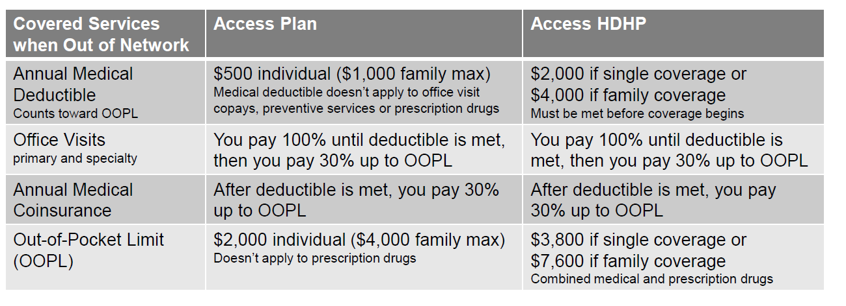
Health Insurance
No changes to medical co-payments, deductibles, co-insurance, out-of-pocket limits.
The Access Plan and Access HDHP offer out-of-network benefits. To learn about the out-of-network benefits, visit: https://etf.wi.gov/its-your-choice/2020/state-employee-retiree-health-plan/health-insurance-employees-cobra-and-retirees-without-medicare/breakdown-your-costs/out-network-health-services
Notes:
With a High Deductible Health Plan, the medical deductible must be met before copays and coinsurance begin.
Example: Before meeting his $1,500 deductible, Joe must pay the full cost of the office visit, including any services or labs. After his deductible, he will only be responsible for 10% of his medical costs.
With a non-high deductible plan, office copays begin before the deductible is met.
Example: Maria chose a health plan with a $250 deductible. Before meeting her deductible, she will pay a $15 copay for an office visit plus the costs of any labs or services. After her deductible, she will continue paying the office visit copay but only be responsible for 10% of labs and services costs.

Slide 33
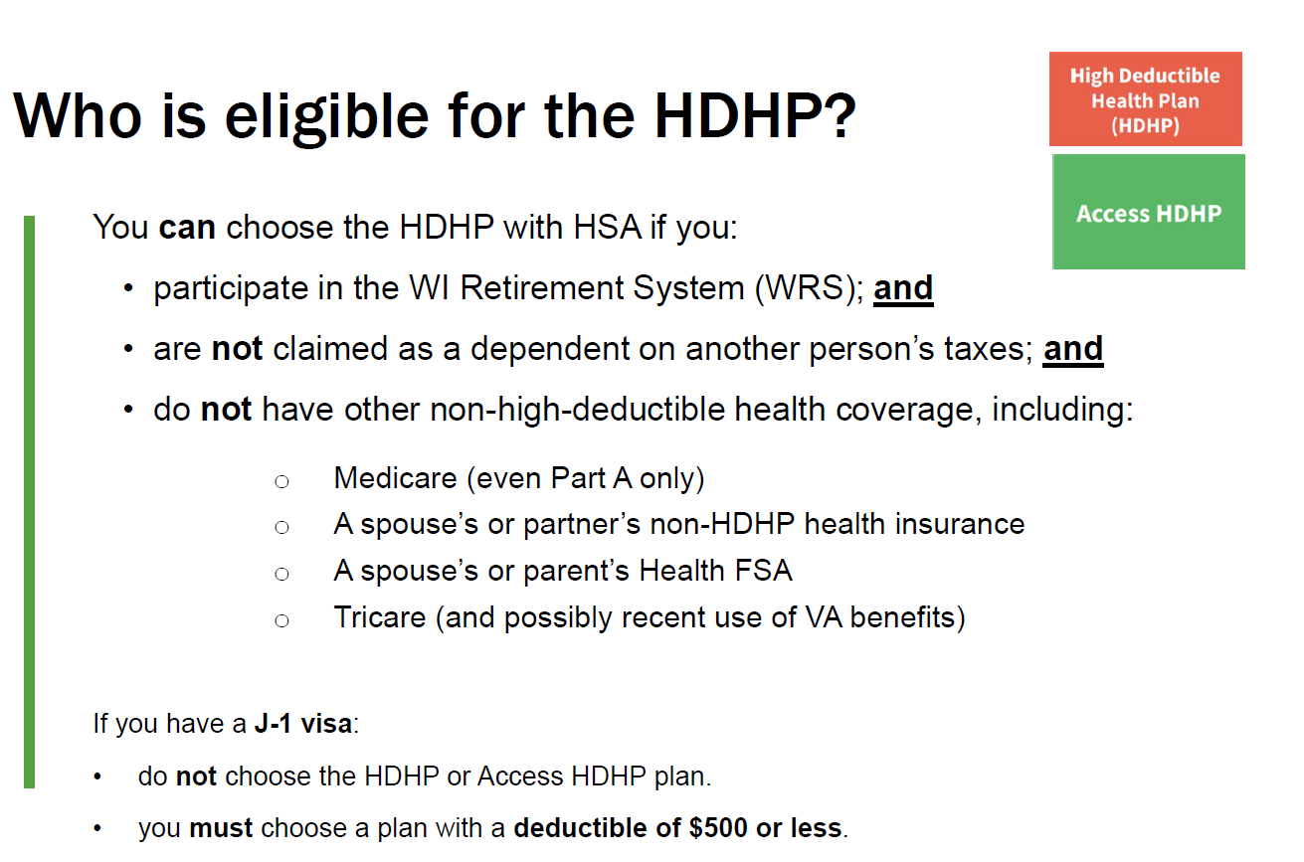
Health Insurance
Notes:
With a High Deductible Health Plan, the medical deductible must be met before copays and coinsurance begin.
Example: Before meeting his $1,500 deductible, Joe must pay the full cost of the office visit, including any services or labs. After his deductible, he will only be responsible for 10% of his medical costs.
With a non-high deductible plan, office copays begin before the deductible is met.
Example: Maria chose a health plan with a $250 deductible. Before meeting her deductible, she will pay a $15 copay for an office visit plus the costs of any labs or services. After her deductible, she will continue paying the office visit copay but only be responsible for 10% of labs and services costs.

Slide 34
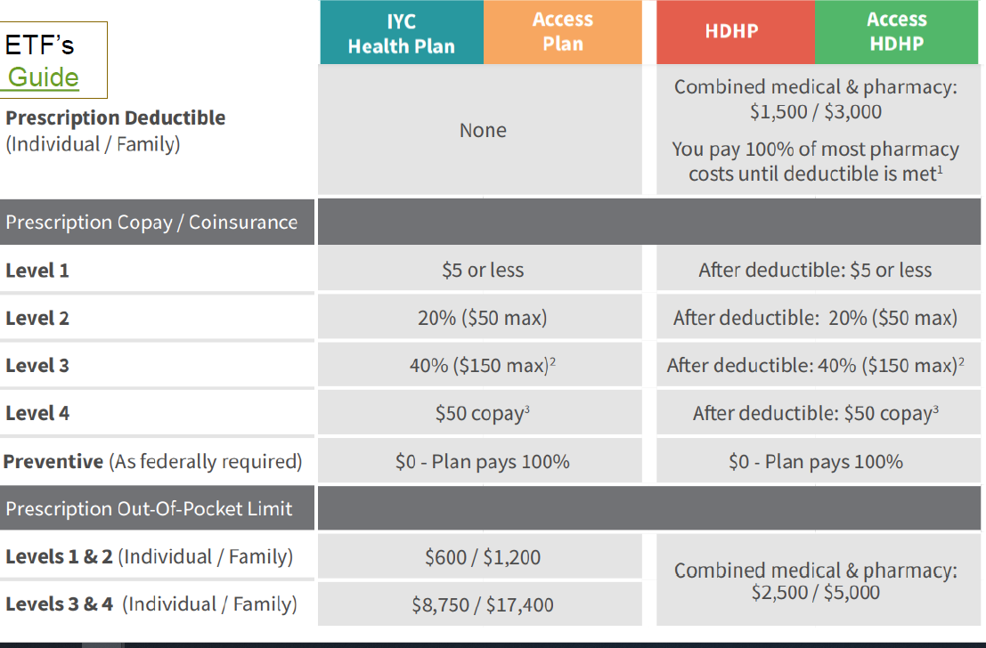
Health Insurance
See page 4 of ETF’s
2022 Decision Guide
Notes:
With a High Deductible Health Plan, the medical deductible must be met before copays and coinsurance begin.
Example: Before meeting his $1,500 deductible, Joe must pay the full cost of the office visit, including any services or labs. After his deductible, he will only be responsible for 10% of his medical costs.
With a non-high deductible plan, office copays begin before the deductible is met.
Example: Maria chose a health plan with a $250 deductible. Before meeting her deductible, she will pay a $15 copay for an office visit plus the costs of any labs or services. After her deductible, she will continue paying the office visit copay but only be responsible for 10% of labs and services costs.

Slide 35
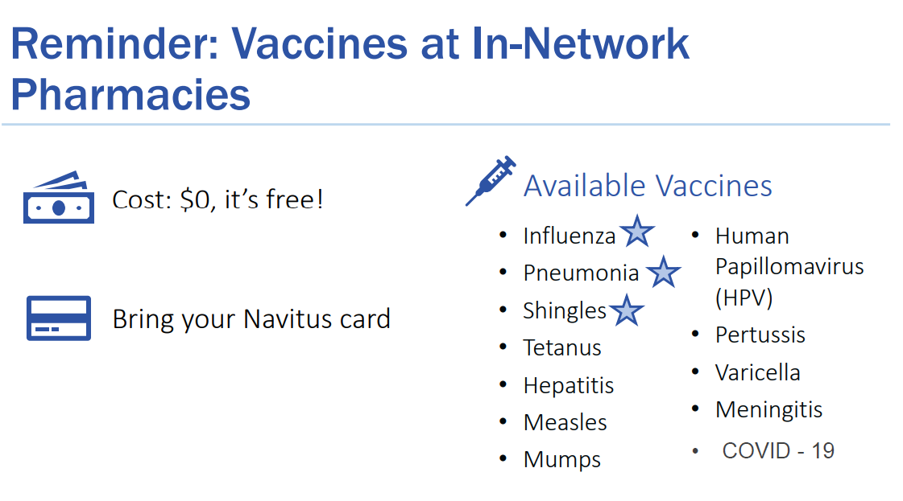
Health Insurance
Notes:
With a High Deductible Health Plan, the medical deductible must be met before copays and coinsurance begin.
Example: Before meeting his $1,500 deductible, Joe must pay the full cost of the office visit, including any services or labs. After his deductible, he will only be responsible for 10% of his medical costs.
With a non-high deductible plan, office copays begin before the deductible is met.
Example: Maria chose a health plan with a $250 deductible. Before meeting her deductible, she will pay a $15 copay for an office visit plus the costs of any labs or services. After her deductible, she will continue paying the office visit copay but only be responsible for 10% of labs and services costs.

Slide 36
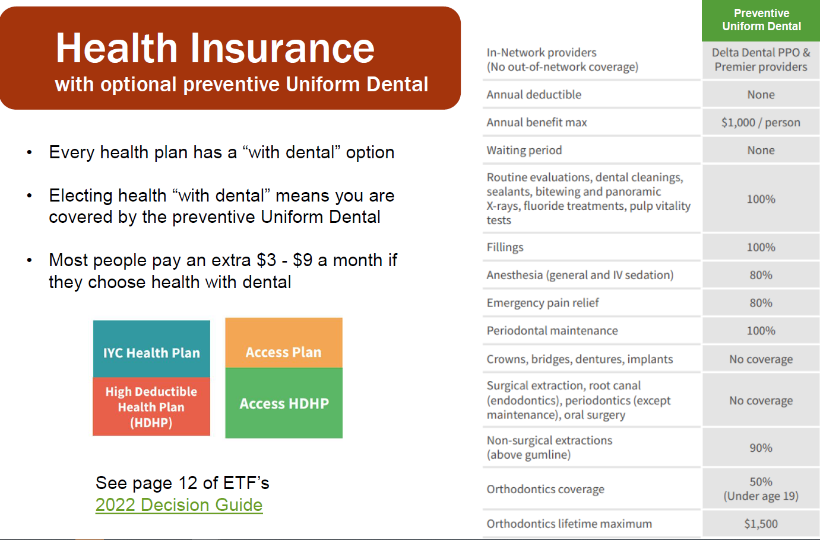
Health Insurance
See page 4 of ETF’s
2022 Decision Guide
Notes:
With a High Deductible Health Plan, the medical deductible must be met before copays and coinsurance begin.
Example: Before meeting his $1,500 deductible, Joe must pay the full cost of the office visit, including any services or labs. After his deductible, he will only be responsible for 10% of his medical costs.
With a non-high deductible plan, office copays begin before the deductible is met.
Example: Maria chose a health plan with a $250 deductible. Before meeting her deductible, she will pay a $15 copay for an office visit plus the costs of any labs or services. After her deductible, she will continue paying the office visit copay but only be responsible for 10% of labs and services costs.

Slide 37
Health Insurance
If employee is seeking services outside the U.S.:
No in-network coverage option outside the United States.
  Access Plan and Access HDHP do offer out-of-network non-emergency coverage for otherwise covered services.
  IYC Health Plan and HDHP cover only certain emergency and urgent care claims if out-of-network.
Notes:
With a High Deductible Health Plan, the medical deductible must be met before copays and coinsurance begin.
Example: Before meeting his $1,500 deductible, Joe must pay the full cost of the office visit, including any services or labs. After his deductible, he will only be responsible for 10% of his medical costs.
With a non-high deductible plan, office copays begin before the deductible is met.
Example: Maria chose a health plan with a $250 deductible. Before meeting her deductible, she will pay a $15 copay for an office visit plus the costs of any labs or services. After her deductible, she will continue paying the office visit copay but only be responsible for 10% of labs and services costs.

Slide 38
Health Insurance
Opt-Out Incentive
If you are a Wisconsin Retirement Service participant:
You can opt-out of the State Group Health plan.
You can receive a $2,000 opt-out incentive, via bi-weekly installments throughout the year.
You must re-elect/sign-up for the Opt-Out incentive every year (during ABE). The stipend does not automatically carry over into 2022. Select opt-out, not waive.
More information:
https://etf.wi.gov/its-your-choice/2022/health-benefits/opt-out-incentive-faqs
Notes:
With a High Deductible Health Plan, the medical deductible must be met before copays and coinsurance begin.
Example: Before meeting his $1,500 deductible, Joe must pay the full cost of the office visit, including any services or labs. After his deductible, he will only be responsible for 10% of his medical costs.
With a non-high deductible plan, office copays begin before the deductible is met.
Example: Maria chose a health plan with a $250 deductible. Before meeting her deductible, she will pay a $15 copay for an office visit plus the costs of any labs or services. After her deductible, she will continue paying the office visit copay but only be responsible for 10% of labs and services costs.

Slide 39
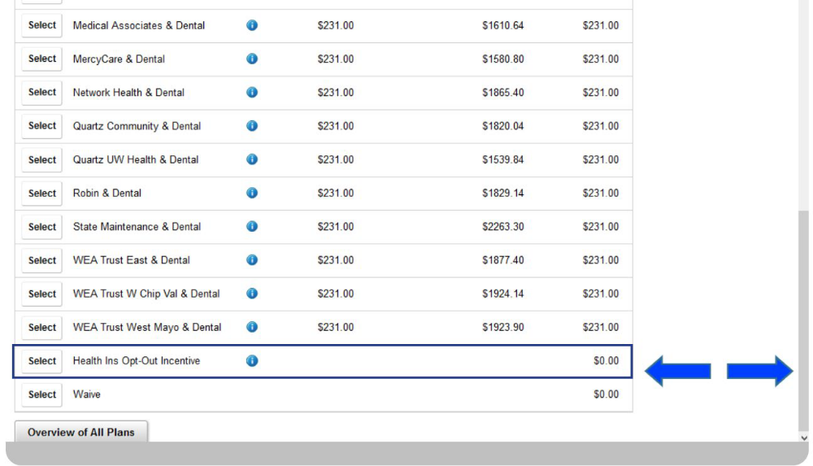
Health Insurance
Opt-Out Incentive
Leaving your election on “Waive” will mean you do not get the $2,000 incentive.
Notes:
With a High Deductible Health Plan, the medical deductible must be met before copays and coinsurance begin.
Example: Before meeting his $1,500 deductible, Joe must pay the full cost of the office visit, including any services or labs. After his deductible, he will only be responsible for 10% of his medical costs.
With a non-high deductible plan, office copays begin before the deductible is met.
Example: Maria chose a health plan with a $250 deductible. Before meeting her deductible, she will pay a $15 copay for an office visit plus the costs of any labs or services. After her deductible, she will continue paying the office visit copay but only be responsible for 10% of labs and services costs.

Slide 40
Dental Insurance
Dental and Vision Insurance
If you have coverage, it will automatically continue.
You can enroll, cancel, or change your coverage.
Notes:
With a High Deductible Health Plan, the medical deductible must be met before copays and coinsurance begin.
Example: Before meeting his $1,500 deductible, Joe must pay the full cost of the office visit, including any services or labs. After his deductible, he will only be responsible for 10% of his medical costs.
With a non-high deductible plan, office copays begin before the deductible is met.
Example: Maria chose a health plan with a $250 deductible. Before meeting her deductible, she will pay a $15 copay for an office visit plus the costs of any labs or services. After her deductible, she will continue paying the office visit copay but only be responsible for 10% of labs and services costs.

Slide 41
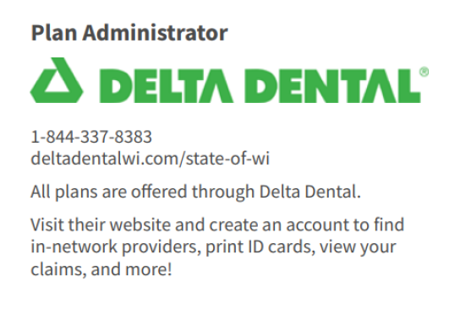
Dental Insurance
Dental Insurance
See pages 11-12 of ETF’s
2022 Decision Guide
Notes:
With a High Deductible Health Plan, the medical deductible must be met before copays and coinsurance begin.
Example: Before meeting his $1,500 deductible, Joe must pay the full cost of the office visit, including any services or labs. After his deductible, he will only be responsible for 10% of his medical costs.
With a non-high deductible plan, office copays begin before the deductible is met.
Example: Maria chose a health plan with a $250 deductible. Before meeting her deductible, she will pay a $15 copay for an office visit plus the costs of any labs or services. After her deductible, she will continue paying the office visit copay but only be responsible for 10% of labs and services costs.

Slide 42
Dental Insurance
Dental Insurance
New Coverage starting January 1, 2022:
Composite/resin (tooth colored) fillings for back teeth are an allowed service on the Uniform Dental and Preventive Dental plans.
Notes:
With a High Deductible Health Plan, the medical deductible must be met before copays and coinsurance begin.
Example: Before meeting his $1,500 deductible, Joe must pay the full cost of the office visit, including any services or labs. After his deductible, he will only be responsible for 10% of his medical costs.
With a non-high deductible plan, office copays begin before the deductible is met.
Example: Maria chose a health plan with a $250 deductible. Before meeting her deductible, she will pay a $15 copay for an office visit plus the costs of any labs or services. After her deductible, she will continue paying the office visit copay but only be responsible for 10% of labs and services costs.

Slide 43
Dental Insurance
Dental Insurance
What Changes Can You Make?
Enroll in coverage.
Change plans (for example, you could switch from Delta Dental PPO-Select to Delta Dental PPO & Premier-Select Plus.)
Add or remove dependents.
Cancel coverage.
Notes:
With a High Deductible Health Plan, the medical deductible must be met before copays and coinsurance begin.
Example: Before meeting his $1,500 deductible, Joe must pay the full cost of the office visit, including any services or labs. After his deductible, he will only be responsible for 10% of his medical costs.
With a non-high deductible plan, office copays begin before the deductible is met.
Example: Maria chose a health plan with a $250 deductible. Before meeting her deductible, she will pay a $15 copay for an office visit plus the costs of any labs or services. After her deductible, she will continue paying the office visit copay but only be responsible for 10% of labs and services costs.

Slide 44
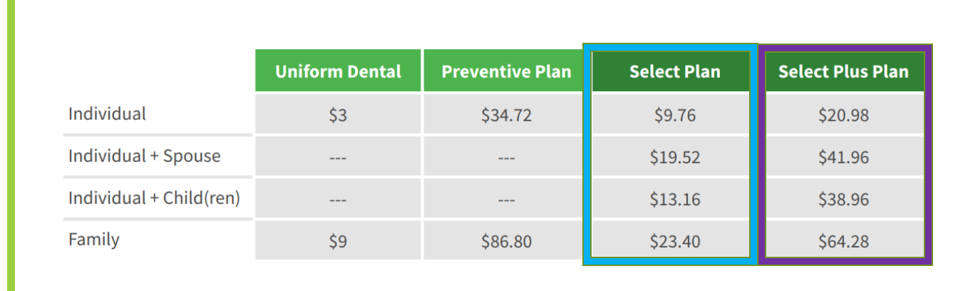
Dental Insurance
Dental Insurance Costs
(shown as monthly premiums which will be divided between your A & B bi-weekly paychecks)
Small increase to cost of most dental options.
Notes:
With a High Deductible Health Plan, the medical deductible must be met before copays and coinsurance begin.
Example: Before meeting his $1,500 deductible, Joe must pay the full cost of the office visit, including any services or labs. After his deductible, he will only be responsible for 10% of his medical costs.
With a non-high deductible plan, office copays begin before the deductible is met.
Example: Maria chose a health plan with a $250 deductible. Before meeting her deductible, she will pay a $15 copay for an office visit plus the costs of any labs or services. After her deductible, she will continue paying the office visit copay but only be responsible for 10% of labs and services costs.

Slide 45
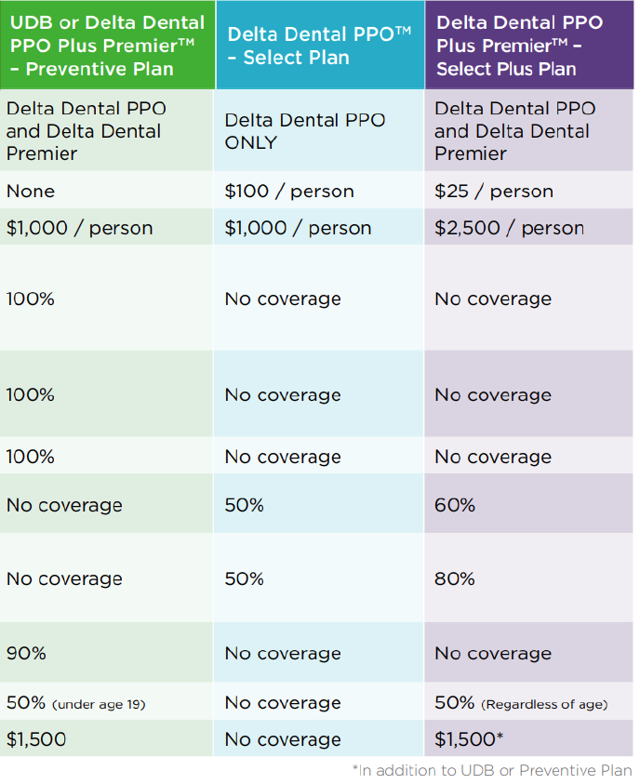
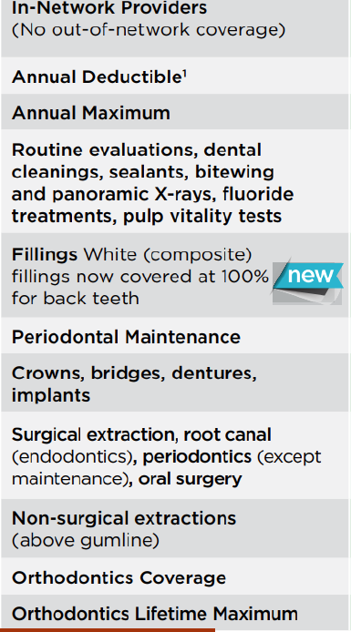
Dental Insurance Comparison Chart
Dental Insurance
https://www.wisconsin.edu/abe/download/DentalComparison.pdf
Notes:
With a High Deductible Health Plan, the medical deductible must be met before copays and coinsurance begin.
Example: Before meeting his $1,500 deductible, Joe must pay the full cost of the office visit, including any services or labs. After his deductible, he will only be responsible for 10% of his medical costs.
With a non-high deductible plan, office copays begin before the deductible is met.
Example: Maria chose a health plan with a $250 deductible. Before meeting her deductible, she will pay a $15 copay for an office visit plus the costs of any labs or services. After her deductible, she will continue paying the office visit copay but only be responsible for 10% of labs and services costs.

Slide 46
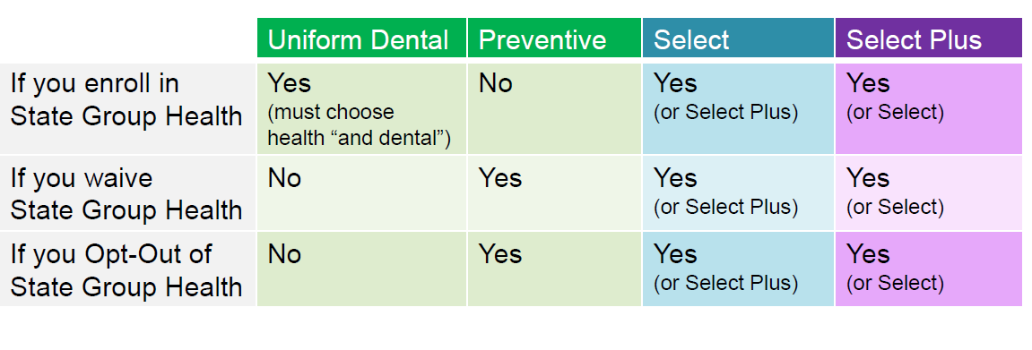
Dental Insurance
Which dental plans can I elect?
Preventive Dental
If you are NOT enrolled in State Group Health, you may elect Preventive Dental to cover basic and preventive dental services.
Supplemental Dental
2 supplemental options through Delta Dental (Select Plan and Select Plus Plan) to help cover extensive treatments or procedures (such as braces or dentures).
Notes:
With a High Deductible Health Plan, the medical deductible must be met before copays and coinsurance begin.
Example: Before meeting his $1,500 deductible, Joe must pay the full cost of the office visit, including any services or labs. After his deductible, he will only be responsible for 10% of his medical costs.
With a non-high deductible plan, office copays begin before the deductible is met.
Example: Maria chose a health plan with a $250 deductible. Before meeting her deductible, she will pay a $15 copay for an office visit plus the costs of any labs or services. After her deductible, she will continue paying the office visit copay but only be responsible for 10% of labs and services costs.

Slide 47
Vision Insurance
Vision Insurance
Delta Vision: 1-844-337-8383
https://www4.deltadentalwi.com/
What Changes Can You Make?
Enroll in coverage
Add or remove dependents
Cancel coverage
See pages 13-14 of ETF’s
2022 Decision Guide
If you have Delta Vision now, it will automatically carry over for 2022.
Notes:
With a High Deductible Health Plan, the medical deductible must be met before copays and coinsurance begin.
Example: Before meeting his $1,500 deductible, Joe must pay the full cost of the office visit, including any services or labs. After his deductible, he will only be responsible for 10% of his medical costs.
With a non-high deductible plan, office copays begin before the deductible is met.
Example: Maria chose a health plan with a $250 deductible. Before meeting her deductible, she will pay a $15 copay for an office visit plus the costs of any labs or services. After her deductible, she will continue paying the office visit copay but only be responsible for 10% of labs and services costs.

Slide 48
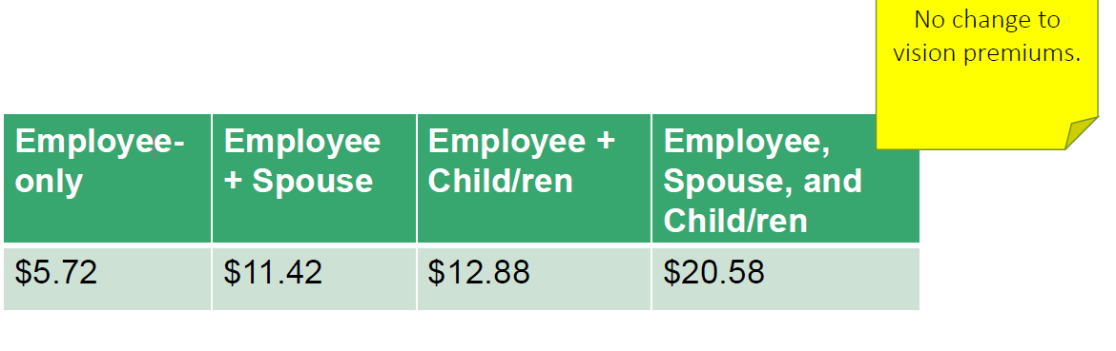
Vision Insurance
Vision Insurance Costs
(shown as monthly premiums that will be divided between your A and B bi-weekly paychecks
Notes:
With a High Deductible Health Plan, the medical deductible must be met before copays and coinsurance begin.
Example: Before meeting his $1,500 deductible, Joe must pay the full cost of the office visit, including any services or labs. After his deductible, he will only be responsible for 10% of his medical costs.
With a non-high deductible plan, office copays begin before the deductible is met.
Example: Maria chose a health plan with a $250 deductible. Before meeting her deductible, she will pay a $15 copay for an office visit plus the costs of any labs or services. After her deductible, she will continue paying the office visit copay but only be responsible for 10% of labs and services costs.

Slide 49

Vision Insurance
Vision Insurance Providers
Visit providers in eyemed’s Insight network for the best coverage:
  https://eyemed.com/en-us
  1-844-337-8383
Notes:
With a High Deductible Health Plan, the medical deductible must be met before copays and coinsurance begin.
Example: Before meeting his $1,500 deductible, Joe must pay the full cost of the office visit, including any services or labs. After his deductible, he will only be responsible for 10% of his medical costs.
With a non-high deductible plan, office copays begin before the deductible is met.
Example: Maria chose a health plan with a $250 deductible. Before meeting her deductible, she will pay a $15 copay for an office visit plus the costs of any labs or services. After her deductible, she will continue paying the office visit copay but only be responsible for 10% of labs and services costs.

Slide 50
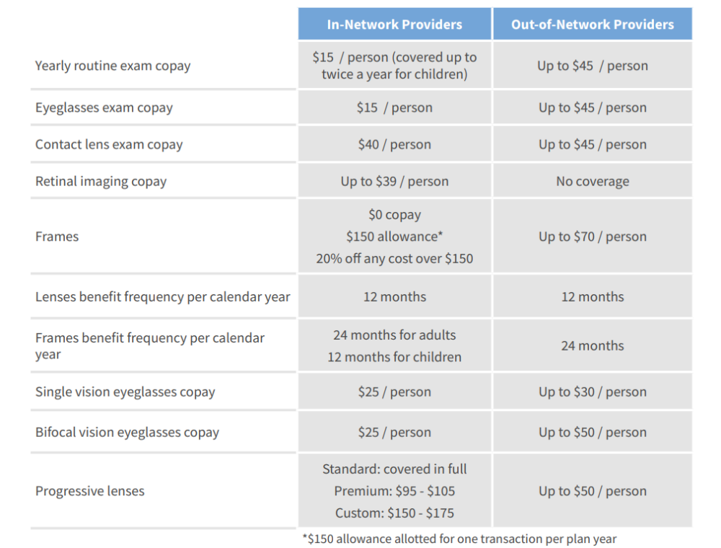
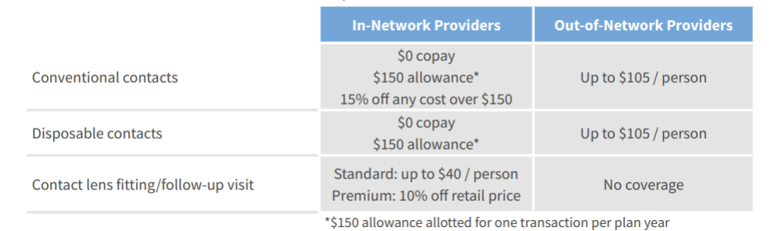
Vision Insurance
Delta Vision EyeMed Coverage
Reminder: You can have coverage for both
contacts and frames in the same year (if you
did not use your frames benefit in 2021), but
You must pay the cost of the glasses’ lenses.
Notes:
With a High Deductible Health Plan, the medical deductible must be met before copays and coinsurance begin.
Example: Before meeting his $1,500 deductible, Joe must pay the full cost of the office visit, including any services or labs. After his deductible, he will only be responsible for 10% of his medical costs.
With a non-high deductible plan, office copays begin before the deductible is met.
Example: Maria chose a health plan with a $250 deductible. Before meeting her deductible, she will pay a $15 copay for an office visit plus the costs of any labs or services. After her deductible, she will continue paying the office visit copay but only be responsible for 10% of labs and services costs.

Slide 51
Pre-Tax Health and Spending Accounts
Pre-Tax Health and Spending Accounts
Members must enroll or re-enroll in Pre-Tax Accounts each year. Current accounts do NOT automatically carry over to 2022.
Health Savings Account (HSA)
  --required if enrolling in the High Deductible Health Plan (HDHP)
Limited Purpose Flexible Spending Account (LPFSA)
  --optional if enrolling in an HDHP
Health Care Flexible Spending Account (Health FSA)
Dependent Day Care Flexible Spending Account (Dependent FSA)
Parking Account
Transit Account
Notes:
With a High Deductible Health Plan, the medical deductible must be met before copays and coinsurance begin.
Example: Before meeting his $1,500 deductible, Joe must pay the full cost of the office visit, including any services or labs. After his deductible, he will only be responsible for 10% of his medical costs.
With a non-high deductible plan, office copays begin before the deductible is met.
Example: Maria chose a health plan with a $250 deductible. Before meeting her deductible, she will pay a $15 copay for an office visit plus the costs of any labs or services. After her deductible, she will continue paying the office visit copay but only be responsible for 10% of labs and services costs.

Slide 52
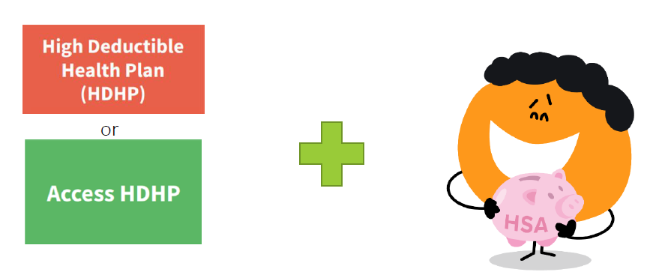
Pre-Tax Health and Spending Accounts
PreTax Accounts
Health Savings Account (HSA)
If you choose the HDHP or Access HDHP you must:
  Open (or reopen) an HSA
  Use Optum Financial/ConnectYourCare (CYC) to open your HSA
Notes:
With a High Deductible Health Plan, the medical deductible must be met before copays and coinsurance begin.
Example: Before meeting his $1,500 deductible, Joe must pay the full cost of the office visit, including any services or labs. After his deductible, he will only be responsible for 10% of his medical costs.
With a non-high deductible plan, office copays begin before the deductible is met.
Example: Maria chose a health plan with a $250 deductible. Before meeting her deductible, she will pay a $15 copay for an office visit plus the costs of any labs or services. After her deductible, she will continue paying the office visit copay but only be responsible for 10% of labs and services costs.

Slide 53
Pre-Tax Health and Spending Accounts
Pre-Tax Accounts
Health Savings Account (HSA)
You can choose the HDHP/HSA plan if you:
participate in the Wisconsin Retirement System (WRS); and
are NOT claimed as a dependent on another person’s taxes; and
do NOT have other non-high-deductible health coverage, including:
  Medicare (even Part A only)
  A spouse’s or partner’s non-HDHP health insurance
  A spouse’s or parent’s Health Flexible Spending Account (FSA)
  Tricare (and possibly recent use of VA benefits)
If you have a J-1 Visa:
  do NOT choose the HDHP or Access HDHP plan.
  you MUST choose a plan with a deductible of $500 or less.
Notes:
With a High Deductible Health Plan, the medical deductible must be met before copays and coinsurance begin.
Example: Before meeting his $1,500 deductible, Joe must pay the full cost of the office visit, including any services or labs. After his deductible, he will only be responsible for 10% of his medical costs.
With a non-high deductible plan, office copays begin before the deductible is met.
Example: Maria chose a health plan with a $250 deductible. Before meeting her deductible, she will pay a $15 copay for an office visit plus the costs of any labs or services. After her deductible, she will continue paying the office visit copay but only be responsible for 10% of labs and services costs.

Slide 54
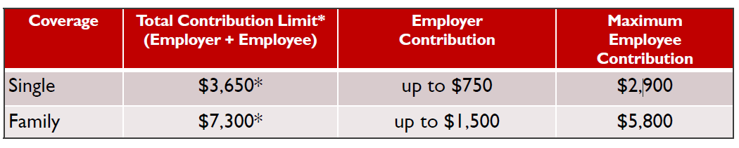
Pre-Tax Health and Spending Accounts
Pre-Tax Accounts
Health Savings Account (HSA)
If you pay the regular employee share for Health Insurance
*If you will be 55+ years of age during 2023, you can contribute an additional $1,000.
Notes:
With a High Deductible Health Plan, the medical deductible must be met before copays and coinsurance begin.
Example: Before meeting his $1,500 deductible, Joe must pay the full cost of the office visit, including any services or labs. After his deductible, he will only be responsible for 10% of his medical costs.
With a non-high deductible plan, office copays begin before the deductible is met.
Example: Maria chose a health plan with a $250 deductible. Before meeting her deductible, she will pay a $15 copay for an office visit plus the costs of any labs or services. After her deductible, she will continue paying the office visit copay but only be responsible for 10% of labs and services costs.

Slide 55

Pre-Tax Health and Spending Accounts
Pre-Tax Accounts
Health Savings Account (HSA)
Information on traditional/low deductible health insurance plans versus High Deductible Health Plans (HDHP) plans can be compared through ALEX. Information on Health Savings Accounts can be found through ConnectYourCare.
https://www.myalex.com/uwsystem/2022#intro
https://connectyourcare.wistia.com/medias/lh7tlg7a9g
Notes:
With a High Deductible Health Plan, the medical deductible must be met before copays and coinsurance begin.
Example: Before meeting his $1,500 deductible, Joe must pay the full cost of the office visit, including any services or labs. After his deductible, he will only be responsible for 10% of his medical costs.
With a non-high deductible plan, office copays begin before the deductible is met.
Example: Maria chose a health plan with a $250 deductible. Before meeting her deductible, she will pay a $15 copay for an office visit plus the costs of any labs or services. After her deductible, she will continue paying the office visit copay but only be responsible for 10% of labs and services costs.

Slide 56
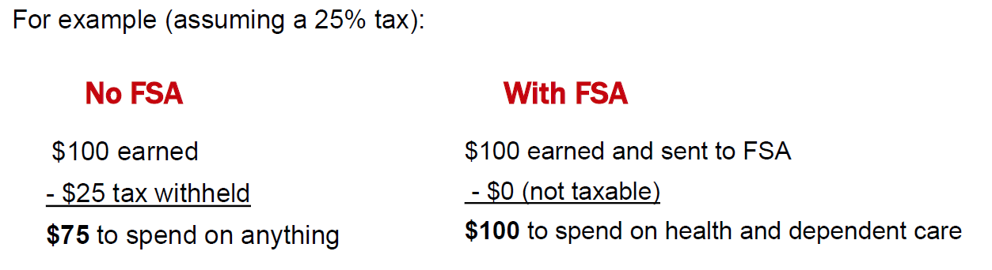
Pre-Tax Health and Spending Accounts
Pre-Tax Accounts
Flexible Spending Account (FSA)
Send money from your paychecks to your FSA.
Use money in your FSA for specific health or dependent care (daycare) costs.
Your FSA money does not count as taxable income.
Notes:
With a High Deductible Health Plan, the medical deductible must be met before copays and coinsurance begin.
Example: Before meeting his $1,500 deductible, Joe must pay the full cost of the office visit, including any services or labs. After his deductible, he will only be responsible for 10% of his medical costs.
With a non-high deductible plan, office copays begin before the deductible is met.
Example: Maria chose a health plan with a $250 deductible. Before meeting her deductible, she will pay a $15 copay for an office visit plus the costs of any labs or services. After her deductible, she will continue paying the office visit copay but only be responsible for 10% of labs and services costs.

Slide 57
Pre-Tax Health and Spending Accounts
Flexible Spending Account (FSA)
Who Can Enroll?
Eligible classifications:
University Staff
University Staff-Fixed Term Finite
Faculty
Academic Staff
Limited appointees
Graduate Assistants (TA, RA)
Rehired annuitants
Not eligible classifications:
University Staff-Temporary
Fellows
Scholars
Trainees
Postdoctoral Fellows/Scholars/Trainees
Grad Intern/Trainee
Notes:
With a High Deductible Health Plan, the medical deductible must be met before copays and coinsurance begin.
Example: Before meeting his $1,500 deductible, Joe must pay the full cost of the office visit, including any services or labs. After his deductible, he will only be responsible for 10% of his medical costs.
With a non-high deductible plan, office copays begin before the deductible is met.
Example: Maria chose a health plan with a $250 deductible. Before meeting her deductible, she will pay a $15 copay for an office visit plus the costs of any labs or services. After her deductible, she will continue paying the office visit copay but only be responsible for 10% of labs and services costs.

Slide 58
Pre-Tax Health and Spending Accounts
Pre-Tax Accounts
Flexible Spending Account (FSA)
You must enroll in an FSA every year (during ABE).
If you enroll now, you can use your FSA to pay for eligible expenses made between January 1 and December 31, 2022.
Your FSA contribution is divided between your 2022 bi-weekly A and B benefits-eligible checks
When you have an eligible expense:
  Use the FSA debit card, or
  Submit claims/receipts to ConnectYourCare
Notes:
With a High Deductible Health Plan, the medical deductible must be met before copays and coinsurance begin.
Example: Before meeting his $1,500 deductible, Joe must pay the full cost of the office visit, including any services or labs. After his deductible, he will only be responsible for 10% of his medical costs.
With a non-high deductible plan, office copays begin before the deductible is met.
Example: Maria chose a health plan with a $250 deductible. Before meeting her deductible, she will pay a $15 copay for an office visit plus the costs of any labs or services. After her deductible, she will continue paying the office visit copay but only be responsible for 10% of labs and services costs.

Slide 59
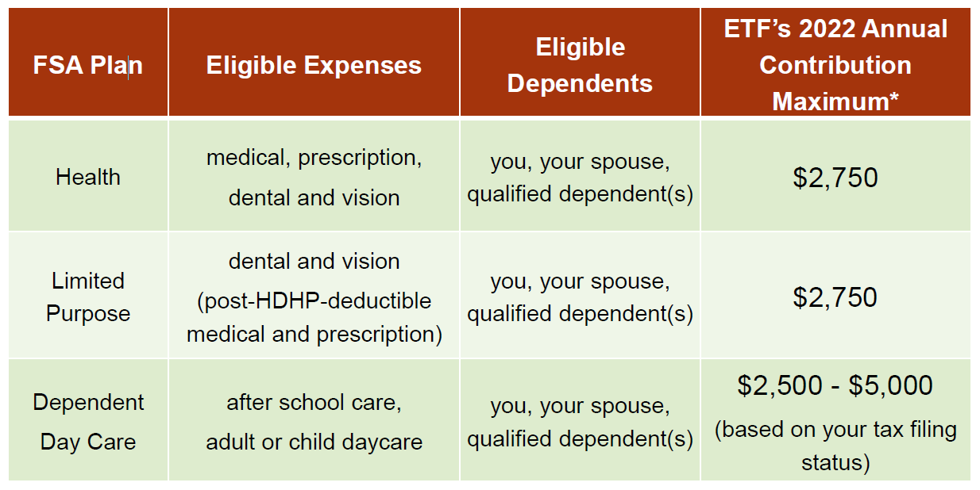
Pre-Tax Health and Spending Accounts
Flexible Spending Account (FSA)
You can roll over $550 from 2021 to 2022 for Health or Limited Purpose FSAs. You cannot roll over money from your Dependent Daycare FSA.
You can spend Health or Limited Purpose FSAs at any time during 2022; you can spend Dependent Daycare FSAs as you deposit it into your account.
Notes:
With a High Deductible Health Plan, the medical deductible must be met before copays and coinsurance begin.
Example: Before meeting his $1,500 deductible, Joe must pay the full cost of the office visit, including any services or labs. After his deductible, he will only be responsible for 10% of his medical costs.
With a non-high deductible plan, office copays begin before the deductible is met.
Example: Maria chose a health plan with a $250 deductible. Before meeting her deductible, she will pay a $15 copay for an office visit plus the costs of any labs or services. After her deductible, she will continue paying the office visit copay but only be responsible for 10% of labs and services costs.

Slide 60
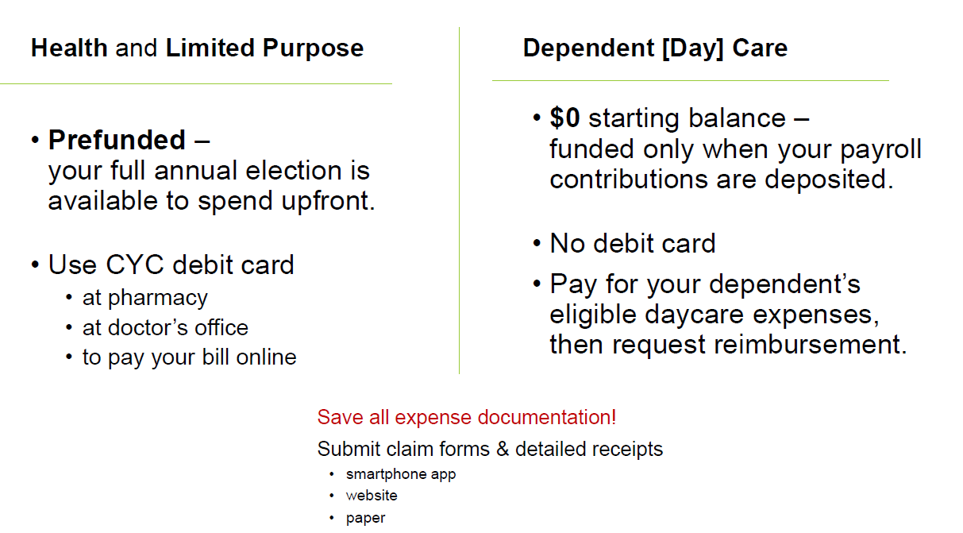
Pre-Tax Health and Spending Accounts
Flexible Spending Account (FSA)
Notes:
With a High Deductible Health Plan, the medical deductible must be met before copays and coinsurance begin.
Example: Before meeting his $1,500 deductible, Joe must pay the full cost of the office visit, including any services or labs. After his deductible, he will only be responsible for 10% of his medical costs.
With a non-high deductible plan, office copays begin before the deductible is met.
Example: Maria chose a health plan with a $250 deductible. Before meeting her deductible, she will pay a $15 copay for an office visit plus the costs of any labs or services. After her deductible, she will continue paying the office visit copay but only be responsible for 10% of labs and services costs.

Slide 61
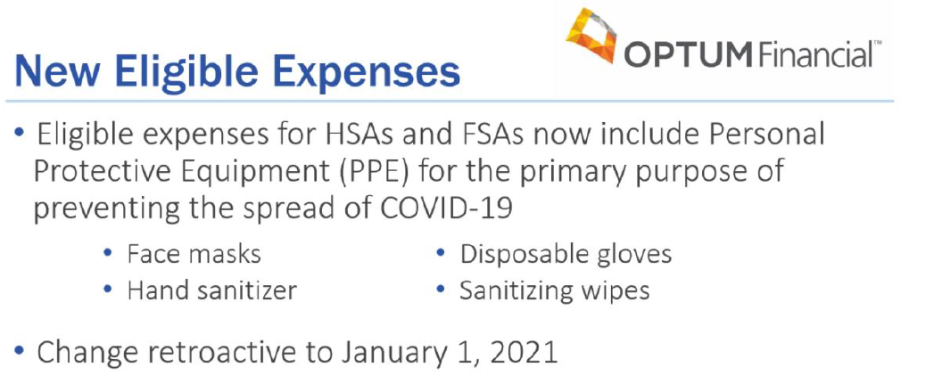
Pre-Tax Health and Spending Accounts
Flexible Spending Account (FSA)
Notes:
With a High Deductible Health Plan, the medical deductible must be met before copays and coinsurance begin.
Example: Before meeting his $1,500 deductible, Joe must pay the full cost of the office visit, including any services or labs. After his deductible, he will only be responsible for 10% of his medical costs.
With a non-high deductible plan, office copays begin before the deductible is met.
Example: Maria chose a health plan with a $250 deductible. Before meeting her deductible, she will pay a $15 copay for an office visit plus the costs of any labs or services. After her deductible, she will continue paying the office visit copay but only be responsible for 10% of labs and services costs.

Slide 62
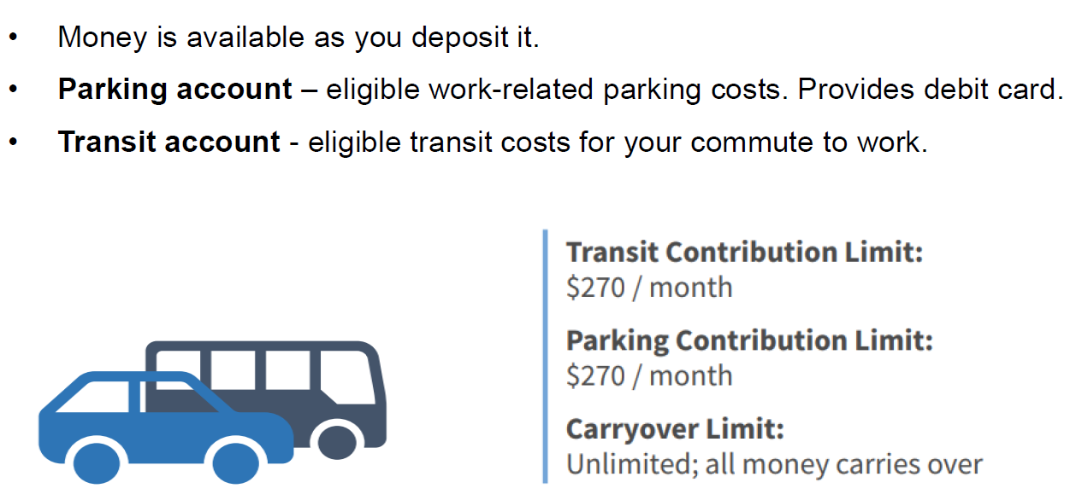
Pre-Tax Parking and Transit
Pre-Tax Accounts
Parking and Transit
Notes:
With a High Deductible Health Plan, the medical deductible must be met before copays and coinsurance begin.
Example: Before meeting his $1,500 deductible, Joe must pay the full cost of the office visit, including any services or labs. After his deductible, he will only be responsible for 10% of his medical costs.
With a non-high deductible plan, office copays begin before the deductible is met.
Example: Maria chose a health plan with a $250 deductible. Before meeting her deductible, she will pay a $15 copay for an office visit plus the costs of any labs or services. After her deductible, she will continue paying the office visit copay but only be responsible for 10% of labs and services costs.

Slide 63
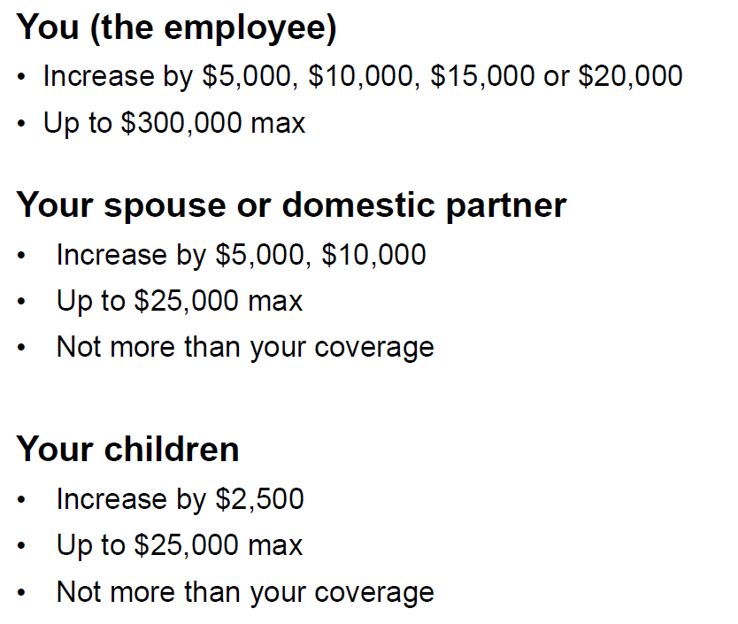
Life Insurance
Individual and Family Life Insurance—Current Participants
Notes:
With a High Deductible Health Plan, the medical deductible must be met before copays and coinsurance begin.
Example: Before meeting his $1,500 deductible, Joe must pay the full cost of the office visit, including any services or labs. After his deductible, he will only be responsible for 10% of his medical costs.
With a non-high deductible plan, office copays begin before the deductible is met.
Example: Maria chose a health plan with a $250 deductible. Before meeting her deductible, she will pay a $15 copay for an office visit plus the costs of any labs or services. After her deductible, she will continue paying the office visit copay but only be responsible for 10% of labs and services costs.

Slide 64
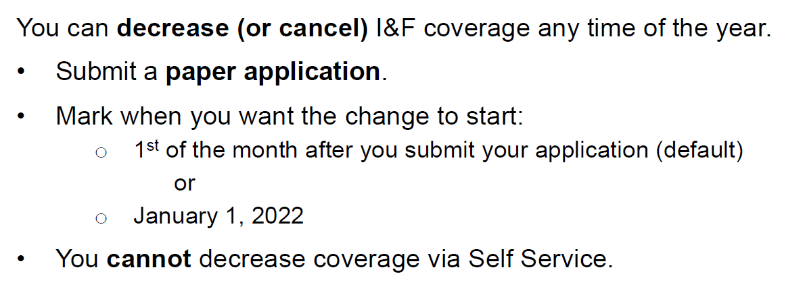
Life Insurance
Individual and Family Life Insurance—Current Participants
Notes:
With a High Deductible Health Plan, the medical deductible must be met before copays and coinsurance begin.
Example: Before meeting his $1,500 deductible, Joe must pay the full cost of the office visit, including any services or labs. After his deductible, he will only be responsible for 10% of his medical costs.
With a non-high deductible plan, office copays begin before the deductible is met.
Example: Maria chose a health plan with a $250 deductible. Before meeting her deductible, she will pay a $15 copay for an office visit plus the costs of any labs or services. After her deductible, she will continue paying the office visit copay but only be responsible for 10% of labs and services costs.

Slide 65
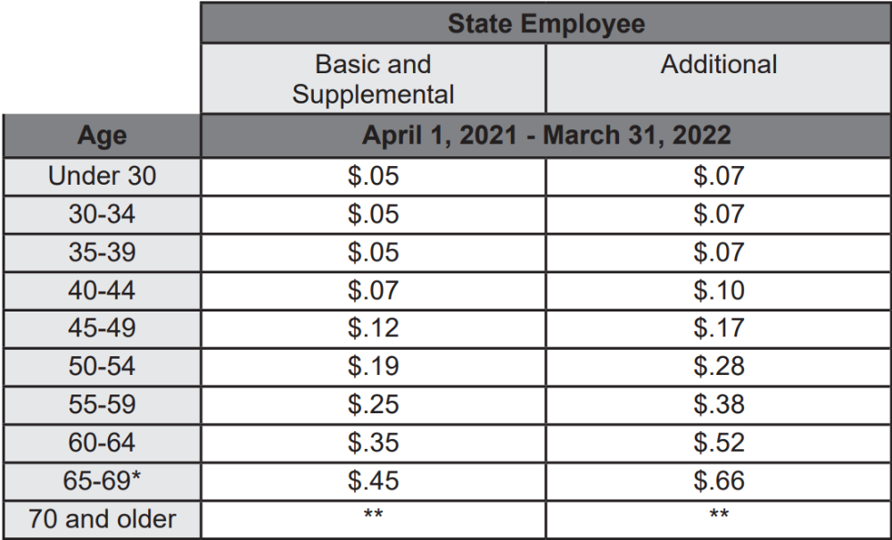
Life Insurance
State Group Life Insurance
Effective April 1, 2022, employee coverage premiums will increase by 5 %.
Spouse/dependent coverage premiums will remain the same ($2.26 for one unit and $4.52 for both units)
New rates, once available, will be here: https://etf.wi.gov/resource/group-life-insurance-plan-monthly-rates
Notes:
With a High Deductible Health Plan, the medical deductible must be met before copays and coinsurance begin.
Example: Before meeting his $1,500 deductible, Joe must pay the full cost of the office visit, including any services or labs. After his deductible, he will only be responsible for 10% of his medical costs.
With a non-high deductible plan, office copays begin before the deductible is met.
Example: Maria chose a health plan with a $250 deductible. Before meeting her deductible, she will pay a $15 copay for an office visit plus the costs of any labs or services. After her deductible, she will continue paying the office visit copay but only be responsible for 10% of labs and services costs.

Slide 66
Life Insurance
University Insurance Assoc. (UIA) Life
2022 plan year runs from 01/01/2022 to 12/31/2022.
No application—those who qualify are enrolled automatically.
Premium is $24 per year and is taken from the check dated 12/16/2021.
Notes:
With a High Deductible Health Plan, the medical deductible must be met before copays and coinsurance begin.
Example: Before meeting his $1,500 deductible, Joe must pay the full cost of the office visit, including any services or labs. After his deductible, he will only be responsible for 10% of his medical costs.
With a non-high deductible plan, office copays begin before the deductible is met.
Example: Maria chose a health plan with a $250 deductible. Before meeting her deductible, she will pay a $15 copay for an office visit plus the costs of any labs or services. After her deductible, she will continue paying the office visit copay but only be responsible for 10% of labs and services costs.

Slide 67
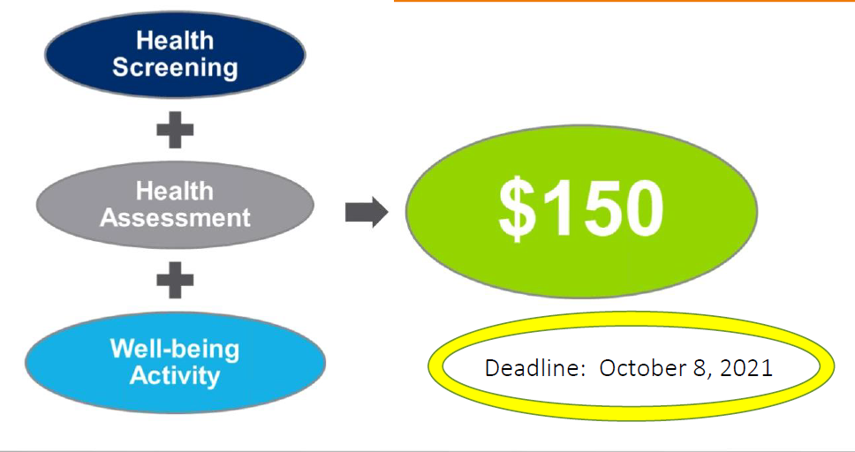
Wellness Incentive 2021
Wellness Incentive deadline is October 8, 2021
https://www.webmdhealth.com/wellwisconsin/
Notes:
With a High Deductible Health Plan, the medical deductible must be met before copays and coinsurance begin.
Example: Before meeting his $1,500 deductible, Joe must pay the full cost of the office visit, including any services or labs. After his deductible, he will only be responsible for 10% of his medical costs.
With a non-high deductible plan, office copays begin before the deductible is met.
Example: Maria chose a health plan with a $250 deductible. Before meeting her deductible, she will pay a $15 copay for an office visit plus the costs of any labs or services. After her deductible, she will continue paying the office visit copay but only be responsible for 10% of labs and services costs.

Slide 68
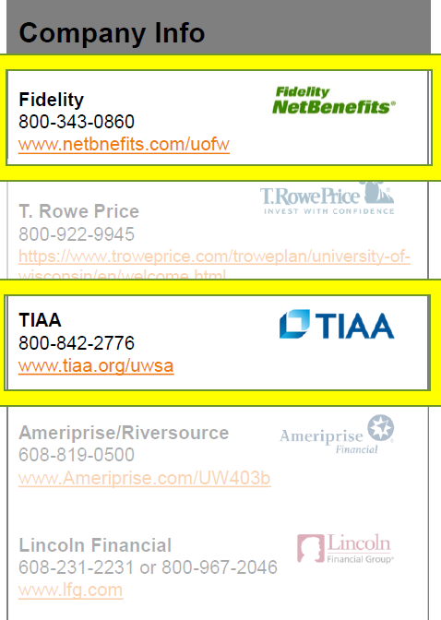
UW’s 403b Supplemental Retirement Plan
Changes for 2022: Reduced Companies
As of January 2022, the UW’s program will only have two companies:
  Fidelity
  TIAA
Visit UW System’s website for more information: https://www.wisconsin.edu/ohrwd/benefits/tsa-changes/
You can enroll at any time by completing a Salary Reduction Agreement and submitting it to Ann or Paula.
Notes:
With a High Deductible Health Plan, the medical deductible must be met before copays and coinsurance begin.
Example: Before meeting his $1,500 deductible, Joe must pay the full cost of the office visit, including any services or labs. After his deductible, he will only be responsible for 10% of his medical costs.
With a non-high deductible plan, office copays begin before the deductible is met.
Example: Maria chose a health plan with a $250 deductible. Before meeting her deductible, she will pay a $15 copay for an office visit plus the costs of any labs or services. After her deductible, she will continue paying the office visit copay but only be responsible for 10% of labs and services costs.

Slide 69
Decide
You must enroll EVERY YEAR if you want to start or continue these benefits:
Health Insurance Opt-Out Incentive*
Health Savings Account (HSA) *
Limited Purposed Flexible Spending Account (LPFSA)*
Health Care Flexible Spending Account (Health FSA)**
Dependent Day Care Flexible Spending Account (Dependent FSA)**
Notes:
With a High Deductible Health Plan, the medical deductible must be met before copays and coinsurance begin.
Example: Before meeting his $1,500 deductible, Joe must pay the full cost of the office visit, including any services or labs. After his deductible, he will only be responsible for 10% of his medical costs.
With a non-high deductible plan, office copays begin before the deductible is met.
Example: Maria chose a health plan with a $250 deductible. Before meeting her deductible, she will pay a $15 copay for an office visit plus the costs of any labs or services. After her deductible, she will continue paying the office visit copay but only be responsible for 10% of labs and services costs.

Slide 70
Decide
You can enroll, change, or cancel:
State Group Health Insurance with or without Uniform Dental (preventive dental).
Preventive Dental (stand-alone dental plan available to those not enrolled in State Group Health).
Supplemental Dental (major/restorative dental coverage only).
Supplemental Vision through Delta Vision.
Accident Plan through Securian.
Accidental Death & Dismemberment (AD&D) Insurance.
Notes:
With a High Deductible Health Plan, the medical deductible must be met before copays and coinsurance begin.
Example: Before meeting his $1,500 deductible, Joe must pay the full cost of the office visit, including any services or labs. After his deductible, he will only be responsible for 10% of his medical costs.
With a non-high deductible plan, office copays begin before the deductible is met.
Example: Maria chose a health plan with a $250 deductible. Before meeting her deductible, she will pay a $15 copay for an office visit plus the costs of any labs or services. After her deductible, she will continue paying the office visit copay but only be responsible for 10% of labs and services costs.

Slide 71
Decide
Individual & Family Life Insurance—if you already have coverage, you can increase your coverage.
Notes:
With a High Deductible Health Plan, the medical deductible must be met before copays and coinsurance begin.
Example: Before meeting his $1,500 deductible, Joe must pay the full cost of the office visit, including any services or labs. After his deductible, he will only be responsible for 10% of his medical costs.
With a non-high deductible plan, office copays begin before the deductible is met.
Example: Maria chose a health plan with a $250 deductible. Before meeting her deductible, she will pay a $15 copay for an office visit plus the costs of any labs or services. After her deductible, she will continue paying the office visit copay but only be responsible for 10% of labs and services costs.

Slide 72

Decide
Notes:
With a High Deductible Health Plan, the medical deductible must be met before copays and coinsurance begin.
Example: Before meeting his $1,500 deductible, Joe must pay the full cost of the office visit, including any services or labs. After his deductible, he will only be responsible for 10% of his medical costs.
With a non-high deductible plan, office copays begin before the deductible is met.
Example: Maria chose a health plan with a $250 deductible. Before meeting her deductible, she will pay a $15 copay for an office visit plus the costs of any labs or services. After her deductible, she will continue paying the office visit copay but only be responsible for 10% of labs and services costs.

Slide 73

Decide
Notes:
With a High Deductible Health Plan, the medical deductible must be met before copays and coinsurance begin.
Example: Before meeting his $1,500 deductible, Joe must pay the full cost of the office visit, including any services or labs. After his deductible, he will only be responsible for 10% of his medical costs.
With a non-high deductible plan, office copays begin before the deductible is met.
Example: Maria chose a health plan with a $250 deductible. Before meeting her deductible, she will pay a $15 copay for an office visit plus the costs of any labs or services. After her deductible, she will continue paying the office visit copay but only be responsible for 10% of labs and services costs.

Slide 74

Decide
Notes:
With a High Deductible Health Plan, the medical deductible must be met before copays and coinsurance begin.
Example: Before meeting his $1,500 deductible, Joe must pay the full cost of the office visit, including any services or labs. After his deductible, he will only be responsible for 10% of his medical costs.
With a non-high deductible plan, office copays begin before the deductible is met.
Example: Maria chose a health plan with a $250 deductible. Before meeting her deductible, she will pay a $15 copay for an office visit plus the costs of any labs or services. After her deductible, she will continue paying the office visit copay but only be responsible for 10% of labs and services costs.

Slide 75

Act
Notes:
With a High Deductible Health Plan, the medical deductible must be met before copays and coinsurance begin.
Example: Before meeting his $1,500 deductible, Joe must pay the full cost of the office visit, including any services or labs. After his deductible, he will only be responsible for 10% of his medical costs.
With a non-high deductible plan, office copays begin before the deductible is met.
Example: Maria chose a health plan with a $250 deductible. Before meeting her deductible, she will pay a $15 copay for an office visit plus the costs of any labs or services. After her deductible, she will continue paying the office visit copay but only be responsible for 10% of labs and services costs.

Slide 76

Act
Notes:
With a High Deductible Health Plan, the medical deductible must be met before copays and coinsurance begin.
Example: Before meeting his $1,500 deductible, Joe must pay the full cost of the office visit, including any services or labs. After his deductible, he will only be responsible for 10% of his medical costs.
With a non-high deductible plan, office copays begin before the deductible is met.
Example: Maria chose a health plan with a $250 deductible. Before meeting her deductible, she will pay a $15 copay for an office visit plus the costs of any labs or services. After her deductible, she will continue paying the office visit copay but only be responsible for 10% of labs and services costs.

Slide 77
Act
How do I submit paper benefits applications?
Email applications to Ann Bradshaw (ann.bradshaw@wisc.edu) or Paula Gates (paula.gates@wisc.edu).
Can I type/scan social security numbers on my applications if I email them?
  Yes—IF you use your wisc.edu email address.
  No—if you use a different email account (such as gmail, yahoo, or Hotmail).
Notes:
With a High Deductible Health Plan, the medical deductible must be met before copays and coinsurance begin.
Example: Before meeting his $1,500 deductible, Joe must pay the full cost of the office visit, including any services or labs. After his deductible, he will only be responsible for 10% of his medical costs.
With a non-high deductible plan, office copays begin before the deductible is met.
Example: Maria chose a health plan with a $250 deductible. Before meeting her deductible, she will pay a $15 copay for an office visit plus the costs of any labs or services. After her deductible, she will continue paying the office visit copay but only be responsible for 10% of labs and services costs.

Slide 78

Act
Notes:
With a High Deductible Health Plan, the medical deductible must be met before copays and coinsurance begin.
Example: Before meeting his $1,500 deductible, Joe must pay the full cost of the office visit, including any services or labs. After his deductible, he will only be responsible for 10% of his medical costs.
With a non-high deductible plan, office copays begin before the deductible is met.
Example: Maria chose a health plan with a $250 deductible. Before meeting her deductible, she will pay a $15 copay for an office visit plus the costs of any labs or services. After her deductible, she will continue paying the office visit copay but only be responsible for 10% of labs and services costs.

Slide 79

Act
Notes:
With a High Deductible Health Plan, the medical deductible must be met before copays and coinsurance begin.
Example: Before meeting his $1,500 deductible, Joe must pay the full cost of the office visit, including any services or labs. After his deductible, he will only be responsible for 10% of his medical costs.
With a non-high deductible plan, office copays begin before the deductible is met.
Example: Maria chose a health plan with a $250 deductible. Before meeting her deductible, she will pay a $15 copay for an office visit plus the costs of any labs or services. After her deductible, she will continue paying the office visit copay but only be responsible for 10% of labs and services costs.

Slide 80
Life Events and Benefits Changes
Some benefits allow enrollments or changes if you submit paper applications within 30 days of a life event.
Life Event Examples:
Marriage
Divorce
Birth/Adoption
Address change to a new county
Loss of other coverage
Life event resources:
https://hr.wisc.edu/benefits/qualifying-life-events/

Slide 81
Questions, Comments, Curiosities?

Slide 82
Slides in case we have time…

Slide 83
Accident Plan
Accident Plan with Securian
If you have coverage, it will automatically continue.
You can enroll, cancel, or change your coverage.
If you have an accident and make a claim, the plan pays you cash.
Coverage includes:
Concussions
Dislocations
Lacerations
Fractures
X-rays
Emergency care
Hospitalization
Surgeries
Follow-up care
Support care
Accidental death dismemberment
Outpatient rehabilitation therapy visits are a covered claim type (NEW)
Notes:
With a High Deductible Health Plan, the medical deductible must be met before copays and coinsurance begin.
Example: Before meeting his $1,500 deductible, Joe must pay the full cost of the office visit, including any services or labs. After his deductible, he will only be responsible for 10% of his medical costs.
With a non-high deductible plan, office copays begin before the deductible is met.
Example: Maria chose a health plan with a $250 deductible. Before meeting her deductible, she will pay a $15 copay for an office visit plus the costs of any labs or services. After her deductible, she will continue paying the office visit copay but only be responsible for 10% of labs and services costs.

Slide 84

Accident Plan
Accident Plan with Securian
Notes:
With a High Deductible Health Plan, the medical deductible must be met before copays and coinsurance begin.
Example: Before meeting his $1,500 deductible, Joe must pay the full cost of the office visit, including any services or labs. After his deductible, he will only be responsible for 10% of his medical costs.
With a non-high deductible plan, office copays begin before the deductible is met.
Example: Maria chose a health plan with a $250 deductible. Before meeting her deductible, she will pay a $15 copay for an office visit plus the costs of any labs or services. After her deductible, she will continue paying the office visit copay but only be responsible for 10% of labs and services costs.

Slide 85

Accidental Death & Dismemberment (AD&D) Insurance
You can enroll in, increase, decrease, or cancel AD&D insurance at any time of the year.
For information on premiums and plan details: https://hr.wisc.edu/benefits/accidental-death-and-dismemberment-insurance/
Notes:
With a High Deductible Health Plan, the medical deductible must be met before copays and coinsurance begin.
Example: Before meeting his $1,500 deductible, Joe must pay the full cost of the office visit, including any services or labs. After his deductible, he will only be responsible for 10% of his medical costs.
With a non-high deductible plan, office copays begin before the deductible is met.
Example: Maria chose a health plan with a $250 deductible. Before meeting her deductible, she will pay a $15 copay for an office visit plus the costs of any labs or services. After her deductible, she will continue paying the office visit copay but only be responsible for 10% of labs and services costs.

Slide 86
Long-Term Care Insurance
Allows enrollment at any time of the year.
Mutual of Omaha Insurance (administered by HealthChoice.
Cost to you would be based on age, gender, and health at time of enrollment.
Learn more by calling 1-800-833-5823.
Notes:
With a High Deductible Health Plan, the medical deductible must be met before copays and coinsurance begin.
Example: Before meeting his $1,500 deductible, Joe must pay the full cost of the office visit, including any services or labs. After his deductible, he will only be responsible for 10% of his medical costs.
With a non-high deductible plan, office copays begin before the deductible is met.
Example: Maria chose a health plan with a $250 deductible. Before meeting her deductible, she will pay a $15 copay for an office visit plus the costs of any labs or services. After her deductible, she will continue paying the office visit copay but only be responsible for 10% of labs and services costs.

Slide 87
Income Continuation Insurance (ICI)
ICI premium costs will decrease in 2022 beginning February 1, 2022.
New rates, once available, will be online:
https://hr.wisc.edu/benefits/income-continuation-insurance/
Notes:
With a High Deductible Health Plan, the medical deductible must be met before copays and coinsurance begin.
Example: Before meeting his $1,500 deductible, Joe must pay the full cost of the office visit, including any services or labs. After his deductible, he will only be responsible for 10% of his medical costs.
With a non-high deductible plan, office copays begin before the deductible is met.
Example: Maria chose a health plan with a $250 deductible. Before meeting her deductible, she will pay a $15 copay for an office visit plus the costs of any labs or services. After her deductible, she will continue paying the office visit copay but only be responsible for 10% of labs and services costs.

Slide 88

Wisconsin Retirement System (WRS)
Your employee WRS contribution percentage is lower in 2022 (from 6.75% down to 6.5%)
Information on the WRS: https://hr.wisc.edu/benefits/wisconsin-retirement-system/
Employee Trust Funds (ETF) WRS video resources: https://eft.wi.gov/video/your-wrs-benefits
Notes:
With a High Deductible Health Plan, the medical deductible must be met before copays and coinsurance begin.
Example: Before meeting his $1,500 deductible, Joe must pay the full cost of the office visit, including any services or labs. After his deductible, he will only be responsible for 10% of his medical costs.
With a non-high deductible plan, office copays begin before the deductible is met.
Example: Maria chose a health plan with a $250 deductible. Before meeting her deductible, she will pay a $15 copay for an office visit plus the costs of any labs or services. After her deductible, she will continue paying the office visit copay but only be responsible for 10% of labs and services costs.

